Slide 1
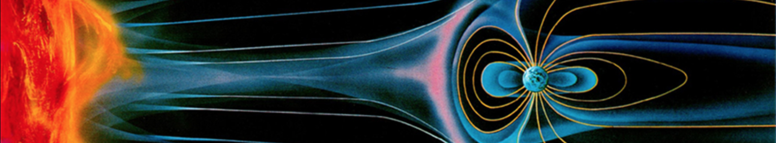

New GOES High-Resolution Magnetic Measurements and Their Contribution to Understanding Magnetospheric Particle Dynamics
R.J. Redmon, T.M. Loto’aniu, A. Boudouridis, P.J. Chi, H.J. Singer, B.T. Kress,
J.V. Rodriguez, M. Tilton, S. Califf, A. Abdelqader,
Rob.Redmon@noaa.gov
NOAA’s National Centers for Environmental Information
December 14, 2017
SM41D-07
National Oceanic and Atmospheric Administration | National Centers for Environmental Information

Slide 2
Outline
History
GOES-16 Early Light Event
GOES MAG Unified
ULF Pc 4-5
Summary
References

Slide 3
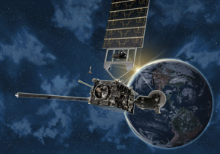
History: Improvements
NOAA–longest GEO record of magnetic field observations.
SMS-1 (May 1974) - era of operational mag measurements.
GOES-8-12 initiated April 13, 1994.
GOES-13-15 initiated May 24, 2006. Presently operational.
GOES-16 (first of GOES-R) - launched Nov 19, 2016.
 | GOES 8-12 | GOES 13-15 | GOES R-U
# Fluxgates | 2* | 2 | 2
Sampling Rate | 2 Hz | 2 Hz | 10 Hz
Filter Cutoff | 0.5 Hz | 0.5 Hz | ~2.5 Hz
Accuracy BOL | 1 nT/axis | 1 nT/axis | TBD
Boom Length | 3 m | 8.5 m | 8.5 m
Notes:
NOAA maintains the longest record of magnetic field observations at GEO.
We’re focusing on 3 constellations, GOES-8-12 w/the first s/c launched in 1994, GOES-13-15, and now GOES-R.
The instrumentation has been improved over these eras including a longer boom, and more effective bandwidth covering the all important ULF to a majority of the EMIC range.

Slide 4
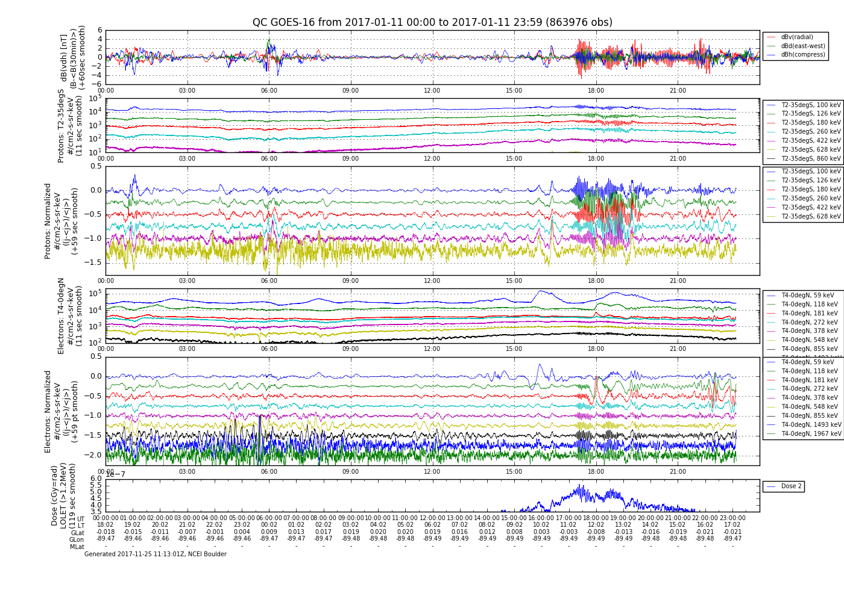
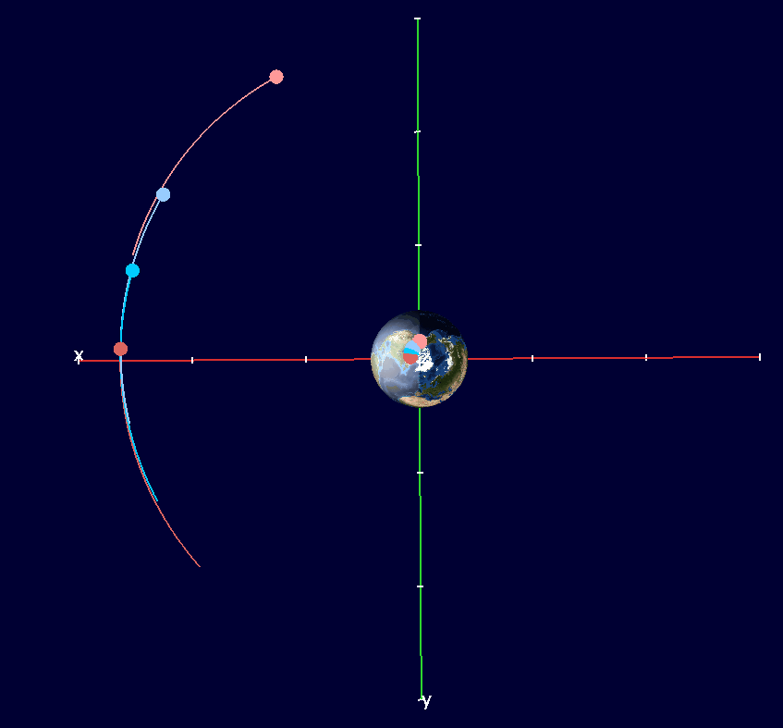
GOES-16: A new GOES era → Early Light Event
1
--- B_{radial}
--- B_{az}
--- B||
GOES-13, 16, 14, 15
17 - 20 UT
Protons
T2-35degS
100-860 keV
2
100 keV
180 keV
422 keV
628 keV
Electrons
T4-0degN
59-855 keV
59 keV
We have ~ 1 year of this 4 s/c configuration.
181 keV
378 keV
1
B: Pc5 (5.5 mHz) w/coherent e-’s, incoherent p+’s.
p+, e-: Packets ~ 2 hour modulated.
p+: Also, 30 mHz present in p+ (next slide).
e-: >1.2 MeV (Dose) on the rise as early as 15UT.
855 keV
~2 MeV
2
Dose
>1.2 MeV
3
3
GOES-16: Non operational data, see disclaimer at end of presentation.
Notes:
We have a full year of 4 spacecraft in this configuration.
We now have 1-second particle data, where previously we only had >2-second.

Slide 5
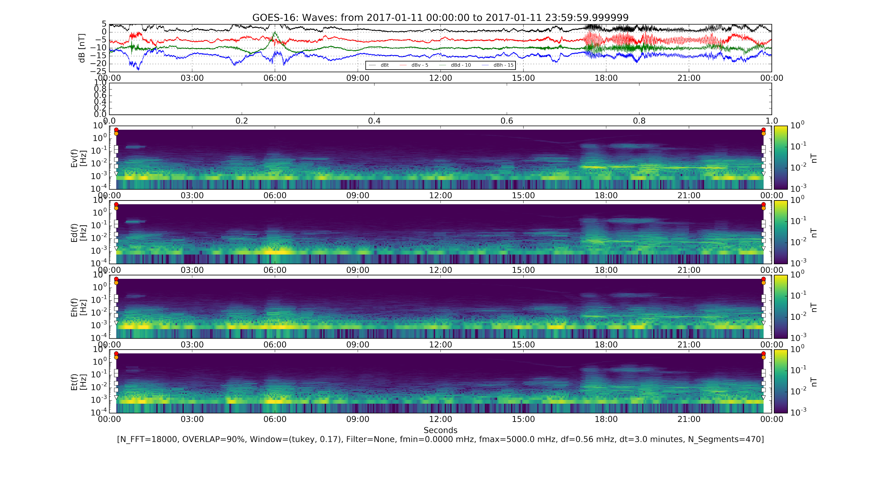
GOES-16 Event:
2017-01-11, 24 hrs
Waves: Pc5, Pc1 & 2 hour envelope.
Pc5 power mostly Radial, aka Poloidal.
Pc1 (0.3 Hz) power similar all components.
1
2
3
GOES-16: Non operational data, see disclaimer at end of presentation.
1
Poloidal (Bv)
0.3 Hz
2
30 mHz
5.5 mHz
3
Toroidal (Bd)
Compressional (Bd)

Slide 6
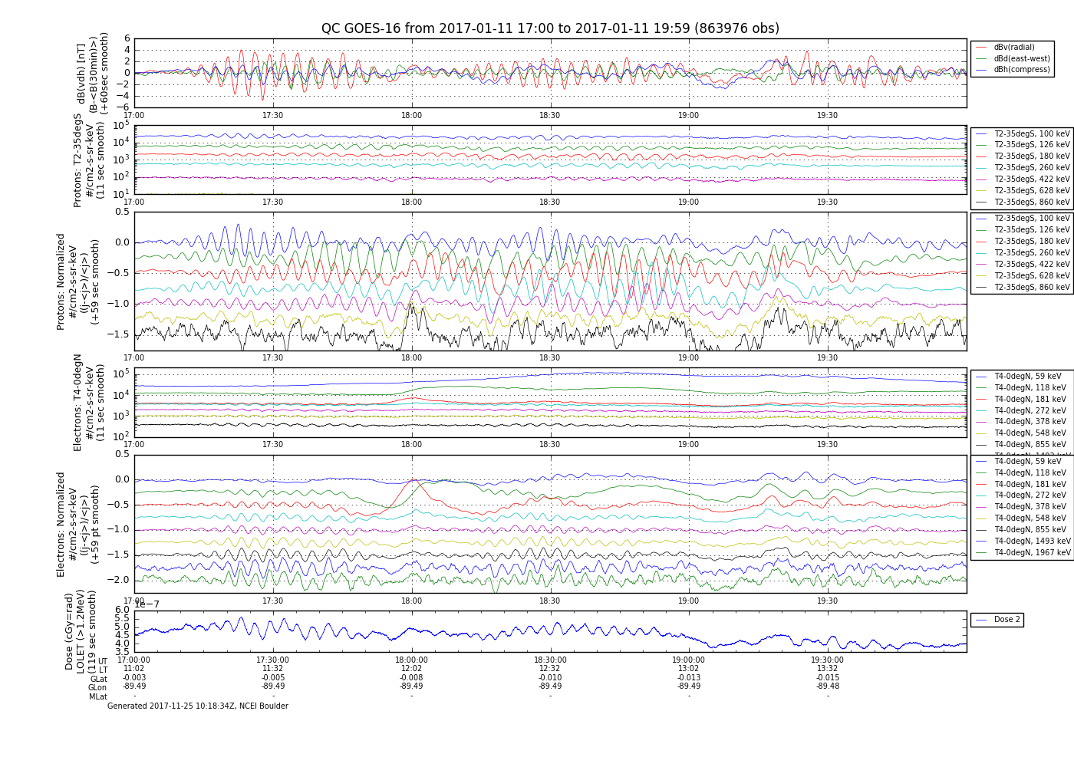
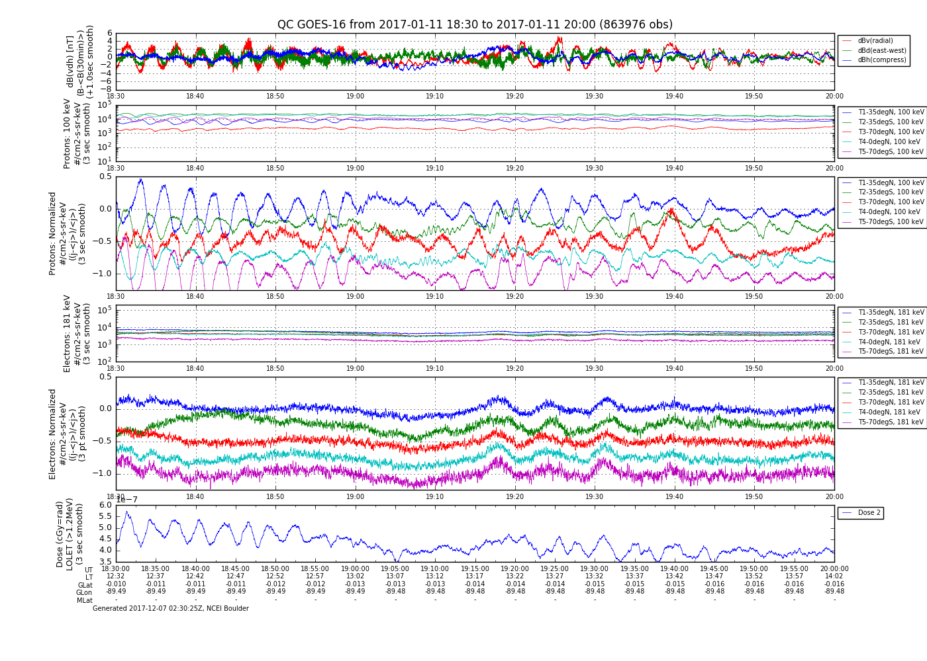
GOES-16 Event:
dB, “Residual flux” 17-20 UT (11-14 LT)
i+: Pc5 (200s, 5 mHz) osc. before B and e-, some energy phase dispersion.
e- and B: Pc5 (180s, 5.5 mHz), no energy phase dispersion.
e-: Preferential energy ~2 MeV.
e-: 118-181 keV, injection signature.
1
2
3
GOES-16: Non operational data, see disclaimer at end of presentation.
4
dB
100 keV protons from the southern hemisphere exhibit 30 mHz (Pc3) and damped 5.5 mHz (Pc5).
B
65°
T4
35°
T2
p+: 30 mHz
T4 (~⟂B), T2
30°
1
p+
100%
2
4
100%
3

Slide 7
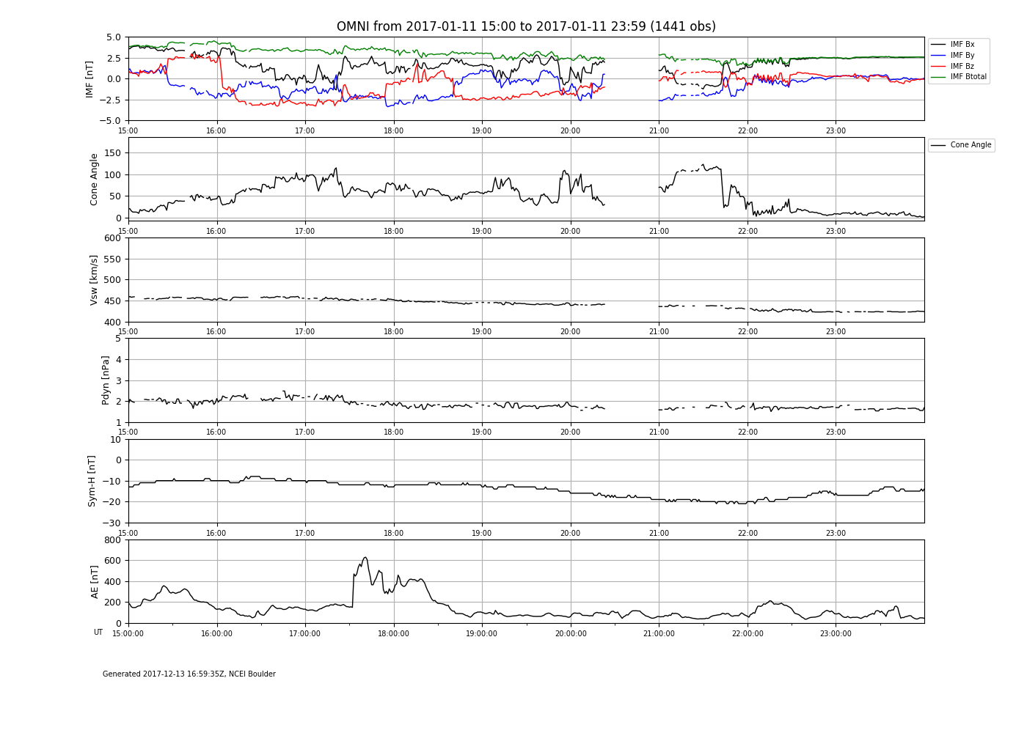
GOES-16: A new GOES era → First Light Event
Observational Review:
2 hrs of ~5 mHz B, e- and p+ (Pc5)
  e- and B coherent, ~2MeV
  p+ and B not coherent
Episodic Pc1 (~0.3 Hz) in B.
  Observed by G13, G14, G16.
Pc5 localized to G16 & G14.
Several e- and p+ injections.
A potential explanation: Mixture
Steady IMF → north turn, some radial.
p+ driving w/d.r. in Pc5, d.b. in Pc3.
p+ injection → obs Pc1/EMIC in B.
e- 2MeV → PSD steepening with R.
e- inj. & AE increase timing match.
Why?
What’s causing the p+ 30 mHz?
Solar Wind and Geomag Activity
IMF
Cone
Vsw
Pdyn
Sym-H
AE
-- Bx
-- By
-- Bz

Slide 8
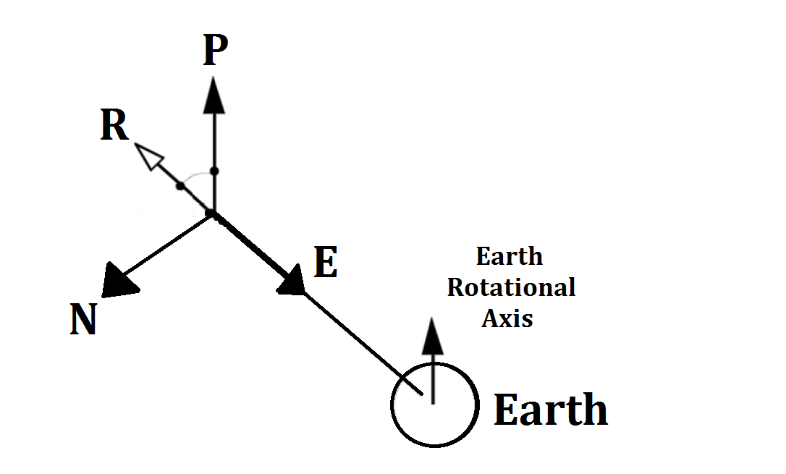
GOES MAG Unified: Objectives
Goal: 20+ year archive, GOES-8-R series
Parameters (NetCDF):
Coordinate (current): Sensor, ECI, EPN
Coordinate (new): GSE, GSM, VDH
Ephemeris, spacecraft location
Data corrections:
Torquer; Calibration Factors;
Coded identification of “Best”
Data Validation: Manual and Automated
Future proofing: Published data, software
Derived products: Pc [1-5] banded power, ULF detection (to 1 Hz); Cross GOES calibration factors.
Coordinate Frames
EPN (classical)
  Local GEO
  E: Earthward
  P: Poleward
  N: Eastward
  ExP = N
VDH (new and used here)
  Dipole Aligned
  V: Radial
  D: East
  H: Dipole North
  VxD = H
H
V
D

Slide 9
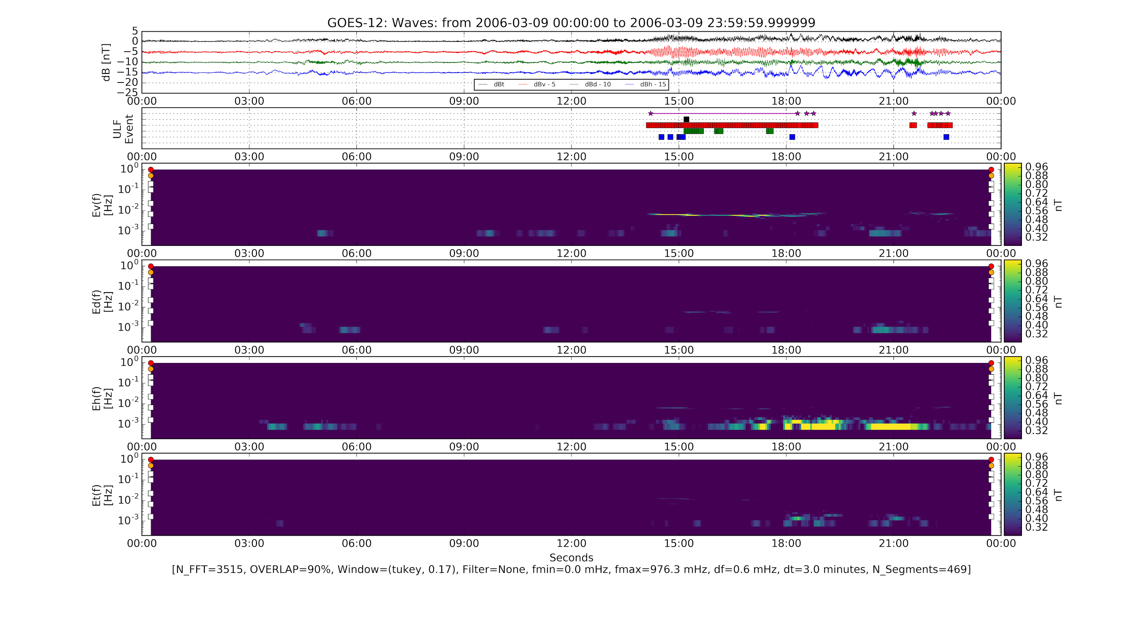
ULF: Automatic Classification
GOES-12 (East) Observes
ULF Pc4-5 for 5 Hours in the ~Poloidal (v) component
Methodology Fourier
Detrend db = B - <B>
PSD Spectrogram
  Tukey window
  90% overlap
  3 Pc5 periods
  df ~ 0.6 mHz
  dt ~ 3 minutes
Simple peak detection
  df/f < 0.25
  B_{peak} > 0.5 nT
Save Intervals
dB
ULF
Bv
Bd
Bh
Bt
Poloidal (Bv)
Toroidal (Bd)
Compress (Bh)
ULF detected
Poloidal

Slide 10
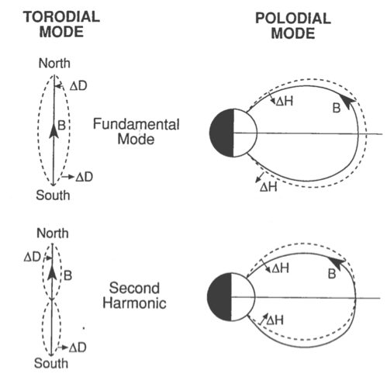

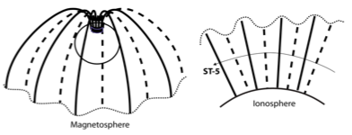
Using a new rich dataset: ULF Pc 4-5 Waves
Theoretical:
Global Oscillations
Observations: Ground
For the next example, ground stations on GEO field line, observe Pc4-5 ULF. Phase cross coherence can be used to confirm FLR nature.
Low Altitude
LEO high-latitude spacecraft such as ST-5 transverse wavefield [3].
FLR Toroidal Mode
ST5
ST5
PBQ
G12
G12
From Le et al. 2011 [3].
GEO
Magnetospheric observations, such as from GOES-12 obs ~Pc4-5 ULF.
(Credit: Andy Kyle, University of Alberta)
Field line oscillation in the 2 lowest frequency toroidal (left) and poloidal (right) modes. (From Hughes et al. 1979 [2])

Slide 11
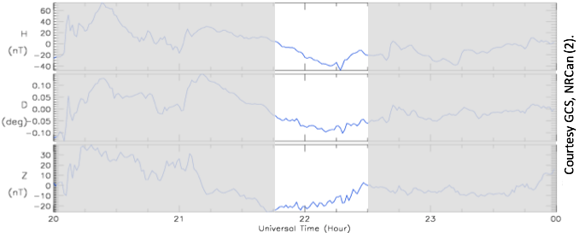
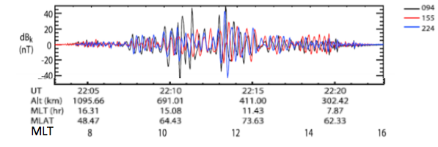
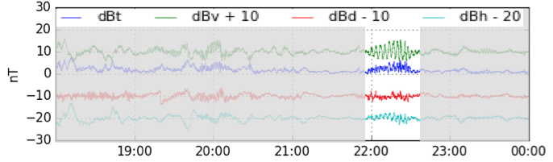
ULF FLR: Case 1: Conjunction Study May 7, 2006
A high-m number, Poloidal mode event near noon on May 7, 2006 presents an example, confirming theoretical predictions of wave propagation from the magnetosphere to the ground [3,4,5].
Ground: Station Post de-la-Baleine (PBQ)
PBQ (65MLat, 352MLon) Pc4-5, ~4.4 mHz, +/-3.1 nT mainly in HDZ(z). FLR nature was confirmed in [3] using cross-phase technique.
Low Altitude: Satellite ST-5
ST5 ~70mHz, +/-20 nT waves in transverse (maximum variance) component (dBk).
Waves were observed in Pc1-2 band, but are Doppler shifted Pc4-5 waves, i.e., they are 5.3+/-1.9 mHz in the Earth frame [3,4].
GEO: GOES-12 (East)
G12 (357 MLon) Pc4-5, ~5.3 mHz, +/-3 nT waves mostly in VDH(v,h) components (in phase).
PBQ
Courtesy GCS, NRCan (3).
ST-5
GOES-12

Slide 12
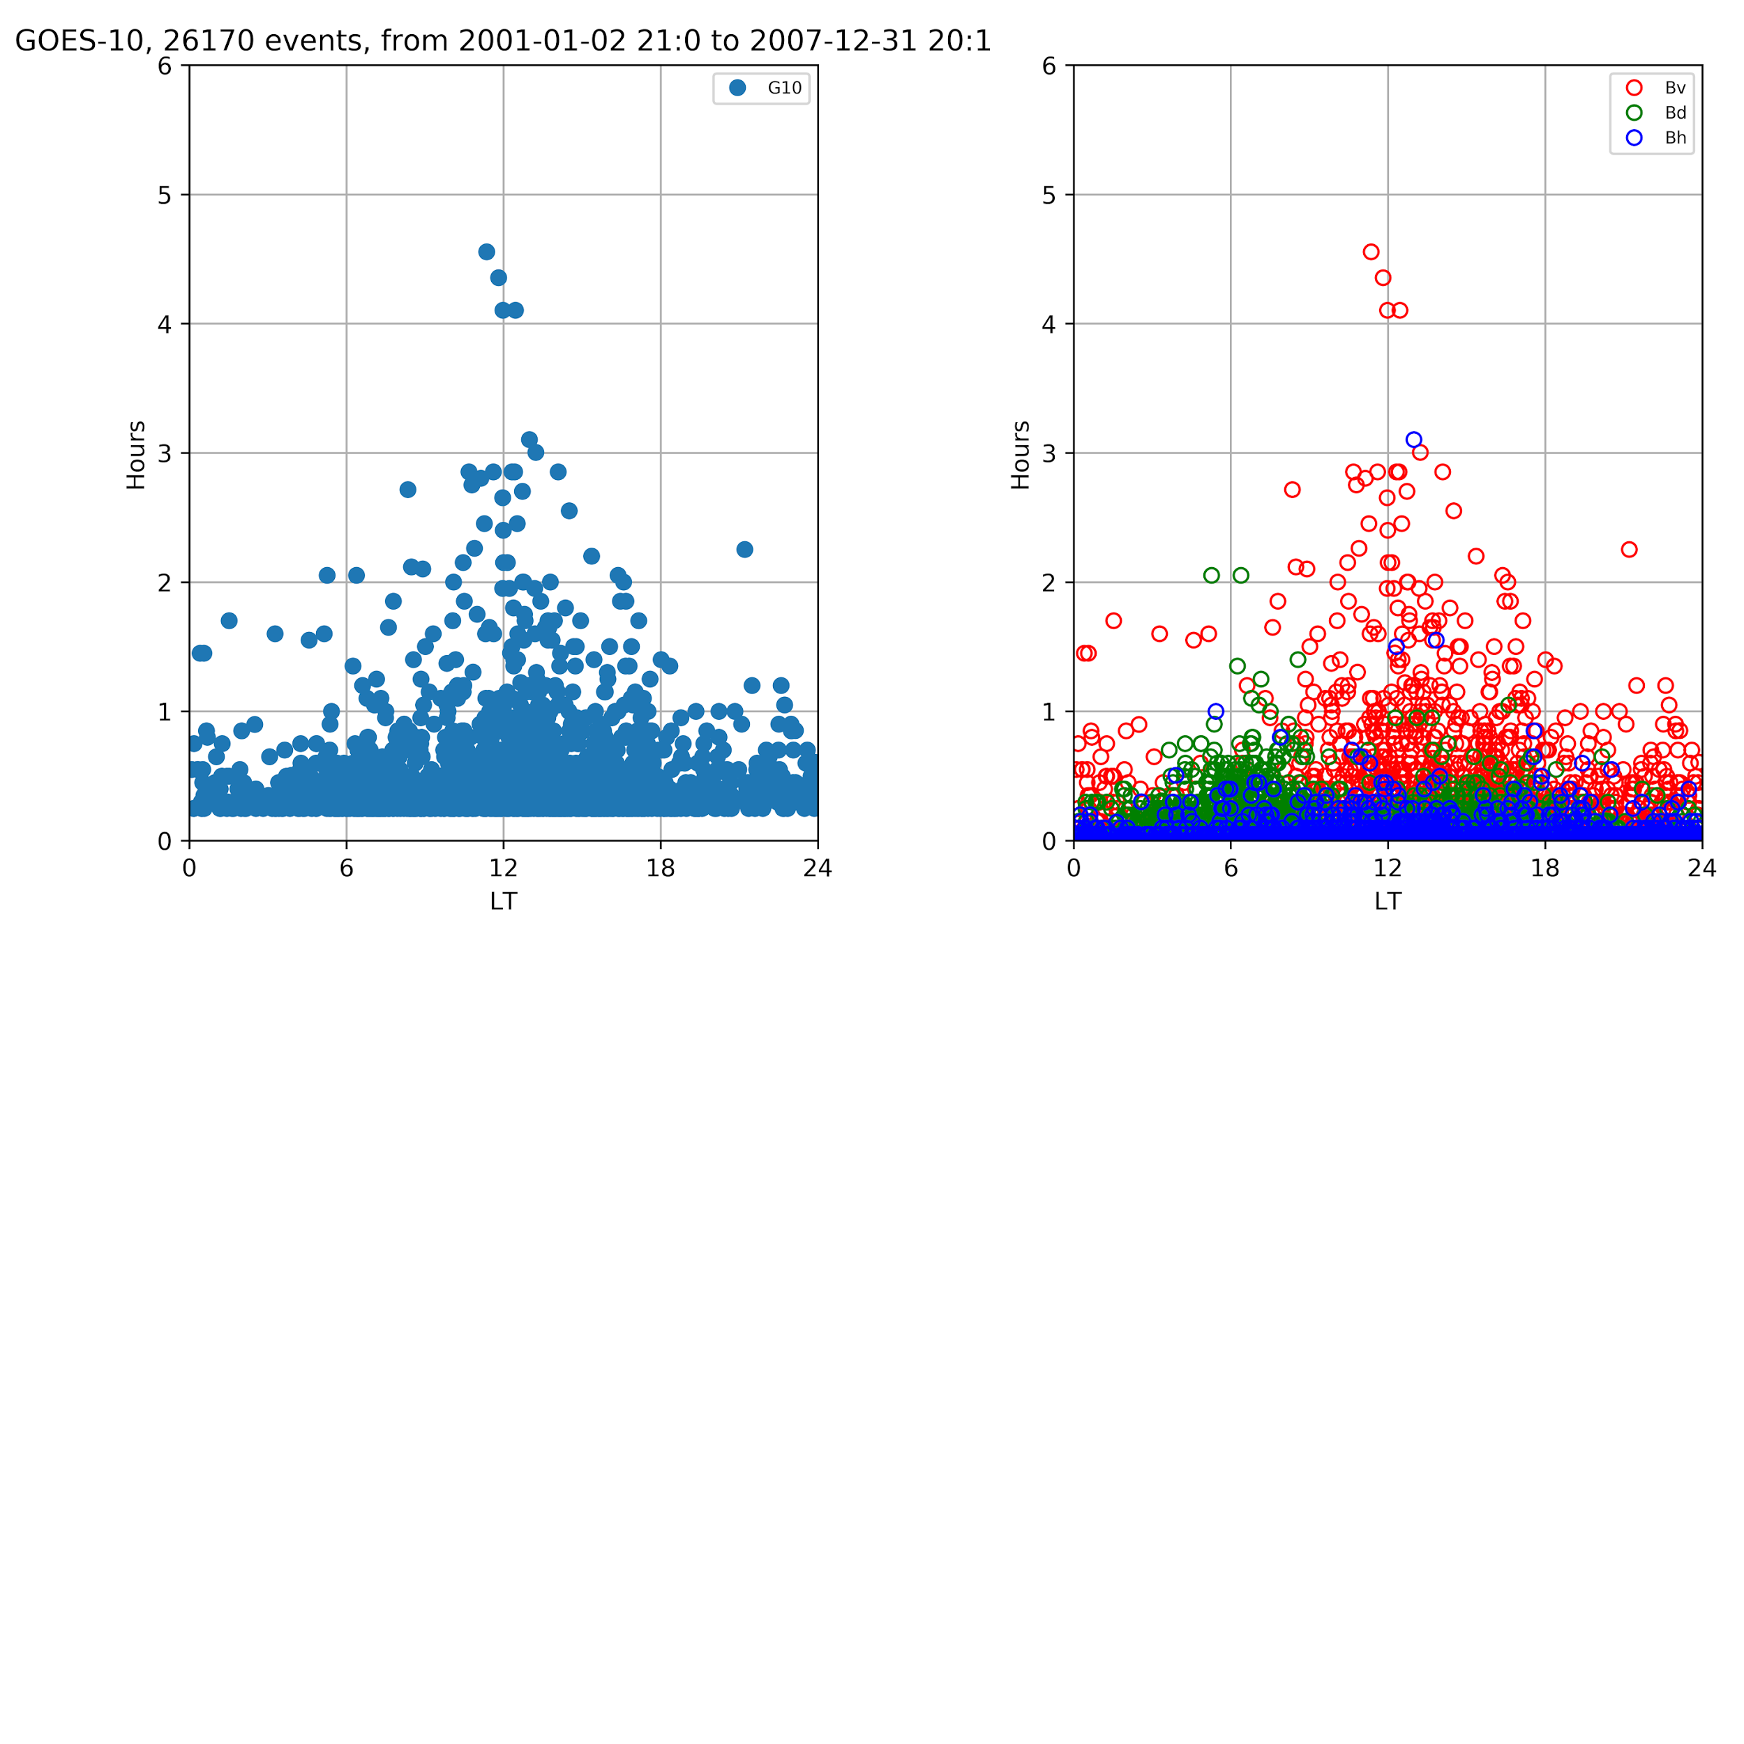
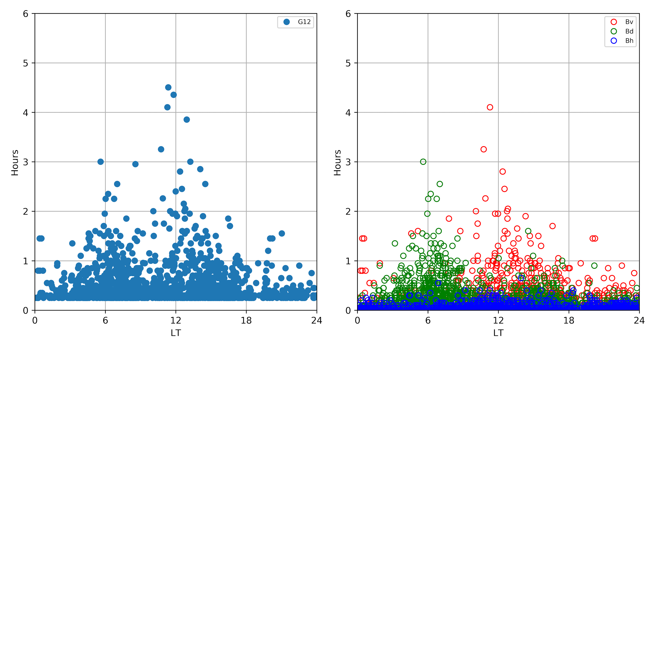
Pc4-5 ULF: Declining phase of SC23 ~2001-2007
Component Comparison
Poloidal (dBv) dominates noon
Toroidal (dBd) dominates flanks w/6>18
Compressional (dBh) limited
Solar wind connection
Significant Events
Longest: 10 hrs on May 24, 2005
  7.3 mHz at 9 LT with 1-5 nT dominant Poloidal (GOES10).
  SpWx: Quiet (see slide 19)
Largest fluctuation (>15 min)
  Oct 1, 2002, with ~ 1hr, >+/- 20 nT in both V, H.
GOES-10&12
26k Events
4
90
Deg
Hours
~2.5-20 mHz
~450 - 50 sec
2
30
1
15
LT
0 6 12 18 24

Slide 13
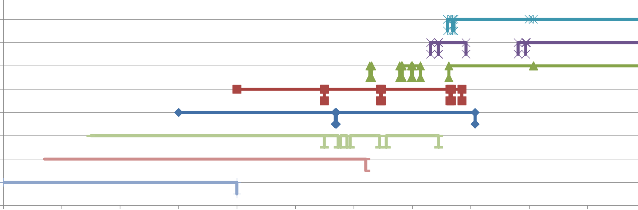
Summary
- New GOES-16 Particle and Field Observations.
- New Reference Archive for GOES 8-15, 1995-Present.
- Geophysical coordinate frames: GSE, GSM, Dipole (VDH)
-- Figures now, new 2Hz and Pc4-5 ULF databases soon:
-- https://satdat.ngdc.noaa.gov/sem/goes/data/reprocess/mag/
G16 (E)
G15 (W)
Feedback is greatly appreciated!
G14 (P)
G13 (E)
G12 (E)
G11 (P)
G10 (W)
G09 (W)
Notional periods of availability, contact rob.redmon@noaa.gov to confirm specific dates.
G08 (E)
1995
1997
1999
2001
2003
2005
2007
2009
2011
2013
2015
2017
2018

Slide 14
Acknowledgements
The authors thank the following persons and institutions for their support:
(1) Funding: NOAA’s Big Earth Data Initiative (PM: J. de la Beaujardière).
(2) A. Newman, L. Matheson, H. Farthing, D. Wilkinson, H. Bysal, D. Niklewski, S. Elkington; NCEI, SWPC.
(3) MAG ground station data was provided by Carisma; David Calp (NRCan/RNCan) via the Geological Survey of Canada (GSC) and National Resources Canada (NRCan). http://www.geomag.nrcan.gc.ca/index-en.php
GOES-16 Disclaimer
“NOAA's GOES-16 satellite has not been declared operational and its data are preliminary and undergoing testing. Users receiving these data through any dissemination means (including, but not limited to, PDA and GRB) assume all risk related to their use of GOES-16 data and NOAA disclaims any and all warranties, whether express or implied, including (without limitation) any implied warranties of merchantability or fitness for a particular purpose.”

Slide 15
Backup Slides

Slide 16
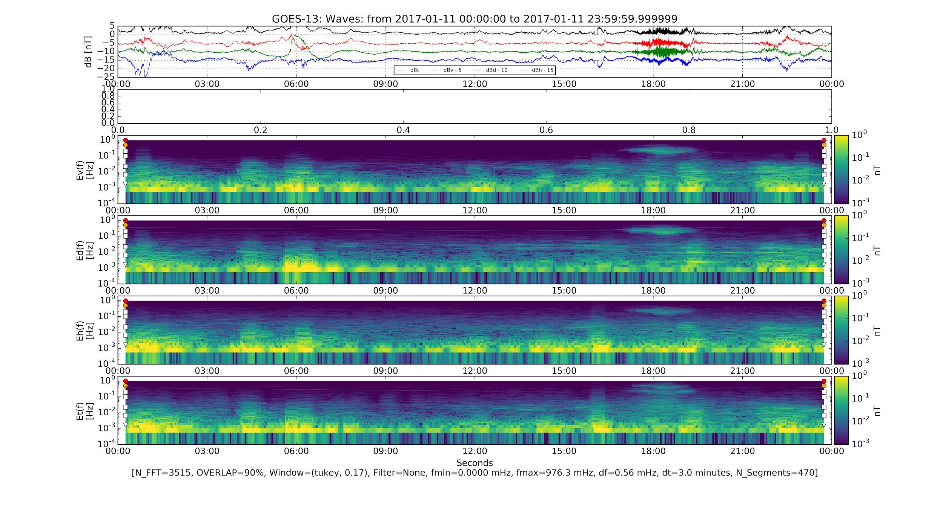
GOES-13 during G16 Event:
2017-01-11, 24 hrs
Waves: Pc1 (like G16), but no Pc5.
Pc1 (0.3 Hz) power similar all components.
1
2
1
Poloidal (Bv)
0.3 Hz
30 mHz
5.5 mHz
2
Toroidal (Bd)
Compressional (Bd)

Slide 17
GOES-14 during G16 Event:
2017-01-11, 24 hrs
Waves: Pc5, Pc1 (like G16).
Pc5 power mostly Radial, aka Poloidal.
Pc1 (0.3 Hz) power similar all components.
1
2
3
1
Poloidal (Bv)
0.3 Hz
30 mHz
5.5 mHz
2
3
Toroidal (Bd)
Compressional (Bd)

Slide 18
Ground stations during Event:
2017-01-11: GILL
Site Site Geodetic Geodetic CGM CGM
Code Name Latitude Longitude Latitude Longitude L GOES-XY
ANNA Ann Arbor 42.417 276.098 52.88 349.51 2.79
BACK Back Lake 57.707 265.794 67.32 333.52 6.83 G16
CONT Contwoyto 65.754 248.750 72.82 304.82 11.64
DAWS Dawson City 64.048 220.890 65.90 273.89 6.09
ESKI Eskimo Point 61.106 265.950 70.52 333.15 9.13
FCHP Fort Chipewyan 58.769 248.894 66.23 308.55 6.25
FCHU Fort Churchill 58.763 265.920 68.32 333.54 7.44
FSIM Fort Simpson 61.756 238.770 67.23 294.29 6.78
FSMI Fort Smith 60.017 248.050 67.28 306.90 6.81
GILL Gillam 56.376 265.360 66.03 333.05 6.15 G16
GOES Footpoint Geographic Foot¹ Geomagnetic Foot² L
G13 East 56.55 280.75 66.15 350.95 6.8
G14 Parking 55.80 260.76 64.14 324.75 6.7
G15 West 58.53 238.28 63.93 296.11 6.6
G16 ~90W 55.74 271.03 64.91 338.06 6.7

Slide 19
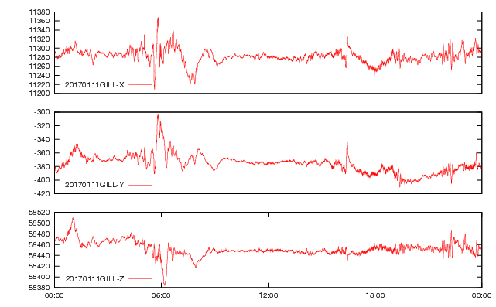
Ground during G16 Event:
2017-01-11: GILL

Slide 20
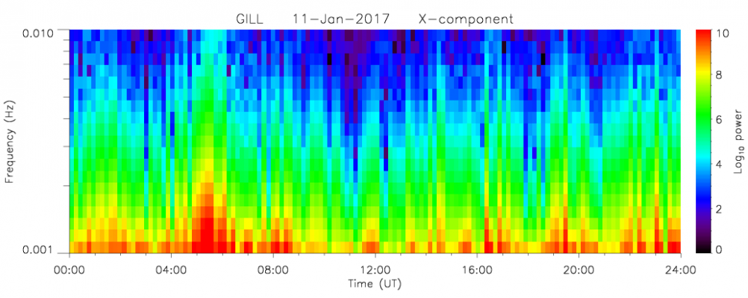
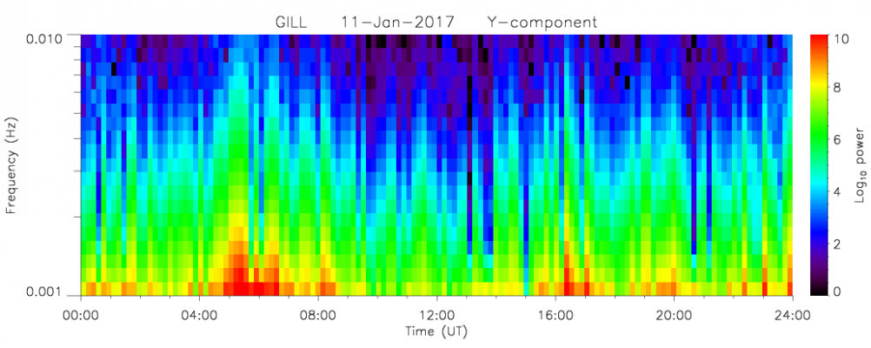
Ground during G16 Event:
2017-01-11: GILL
5.5 mHz
5.5 mHz

Slide 21
Big Earth Data Initiative (BEDI)
Public Access to Research Results
The US Office of Science Technology Policy (OSTP) issued the Memo: “Increasing Access to the Results of Federally Funded Scientific Research” (February 22, 2013) [8].
Agencies with >$100M in annual research: results must be made available to the public, industry, and scientific community.
Big Earth Data Initiative (BEDI)
NOAA’s response: the Big Environmental Data Initiative (BEDI) [9]
Multi‐agency activity through the US Group on Earth Observations
Improve data discoverability, accessibility, and usability

Slide 22
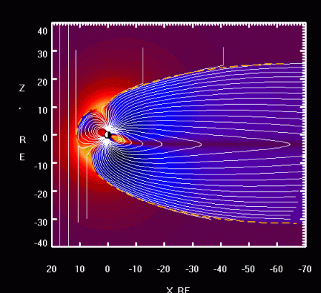
History: Research and Applications
Our thoughts while creating new magnetometer products...
Ring current and radiation belts
Conjunction studies
Plasma waves
Magnetic field modeling
Storm, substorm dynamics
S/C Intercalibration
Thus, your feedback is critical for the best outcome!
http://geo.phys.spbu.ru/~tsyganenko/modeling.html

Slide 23
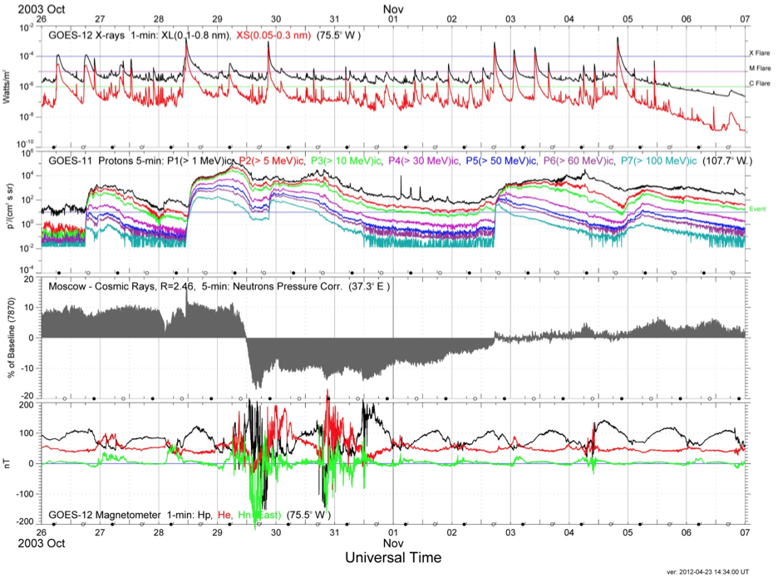
GOES MAG: Space Wx Suite
Halloween Storm 2003 GOES-11 (107W) and GOES-12 (75W)
X-rays
Watts/m2
Multiple X class flares
Protons
#/cm2/s/sr
Multiple SEP events
GCR
%
Forbush Decrease
B field
nT
MP Crossings

Slide 24
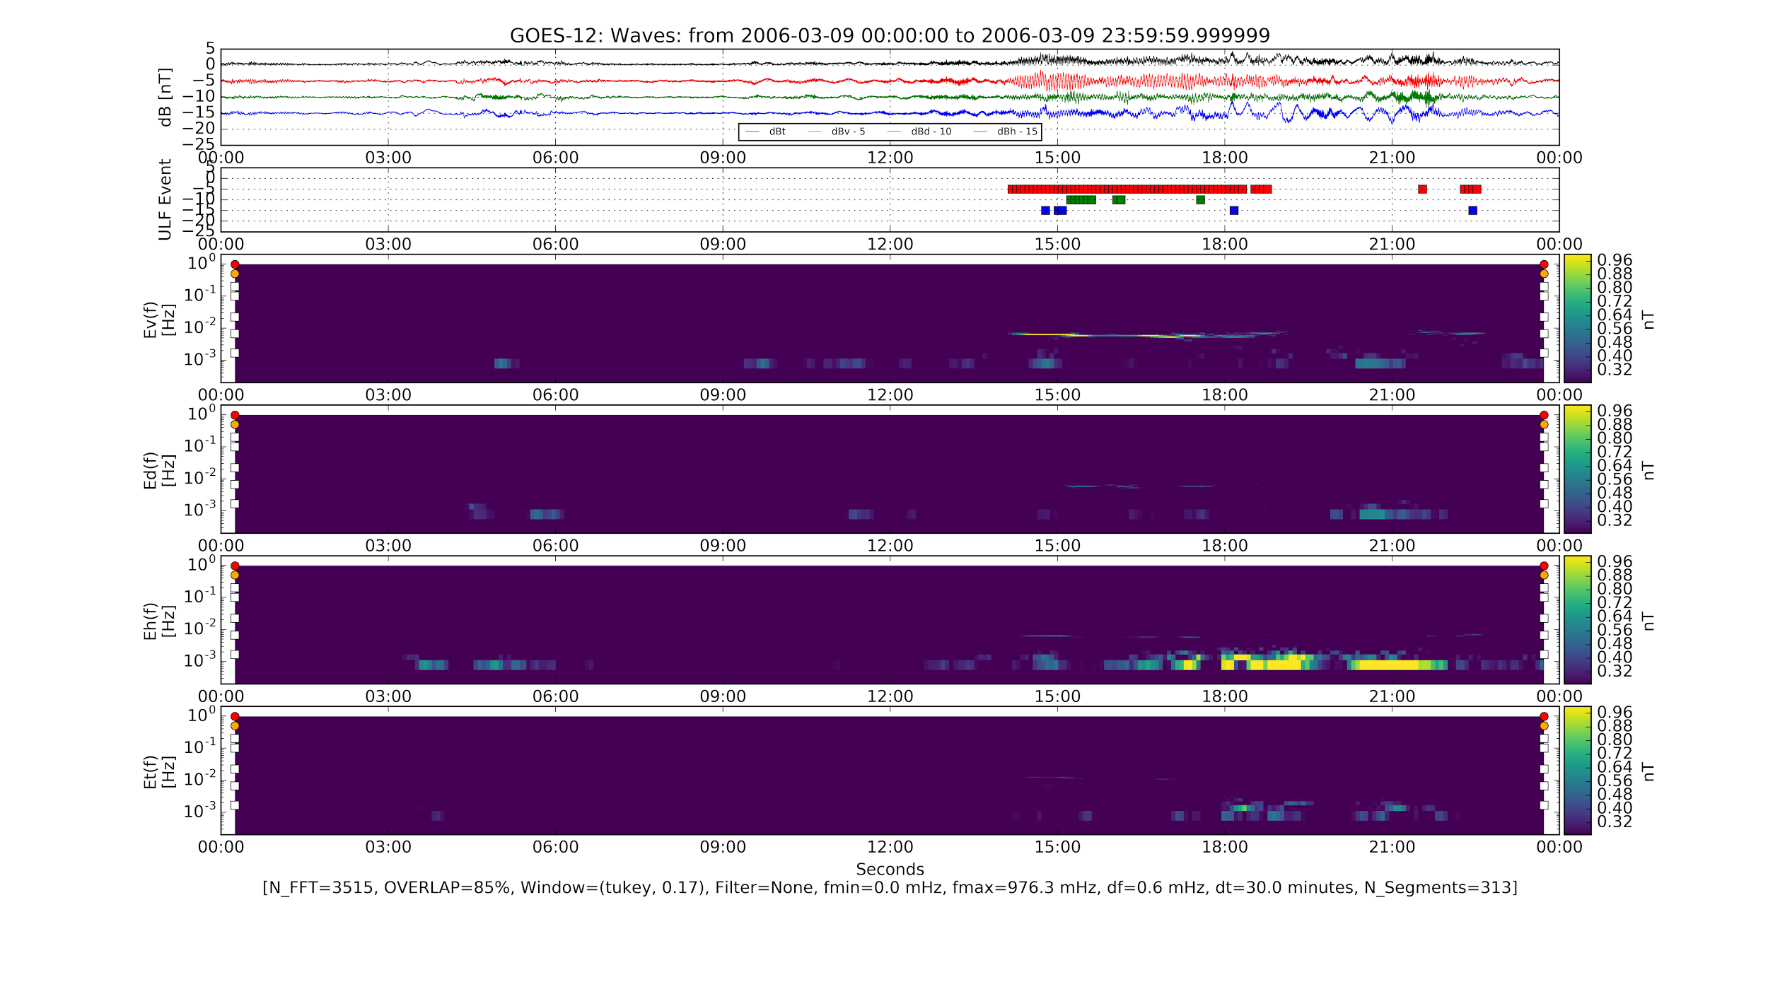
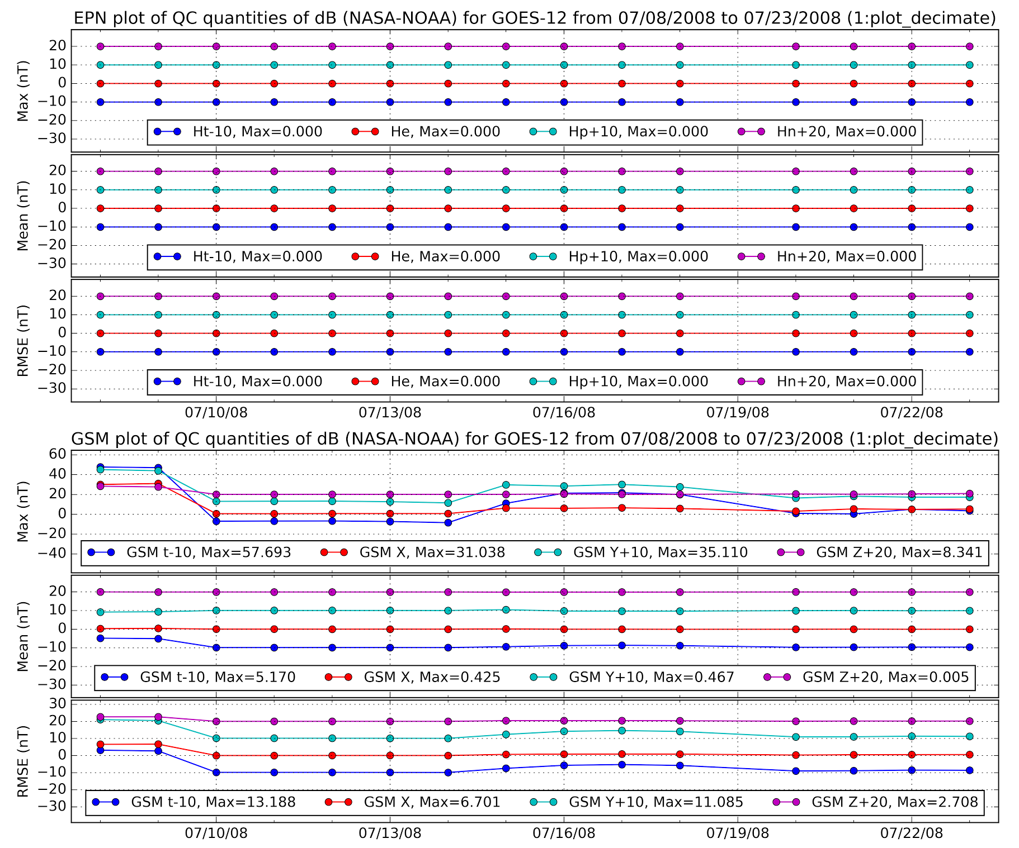
Reference Archives: Validation is Key!
Manual
Quality Figures
  Time series
  Spectrogram
  X-Y scatter
Automated (in progress)
Versus NOAA Orig Set (CDAWeb)
Versus NOAA Future Set
Triggers to detect
  Spikes, heaters, Rx wheel
Intercalibration factors
Automatic
Automated Detection of ULF Pc4-5
Errors detected against “Past” set

Slide 25
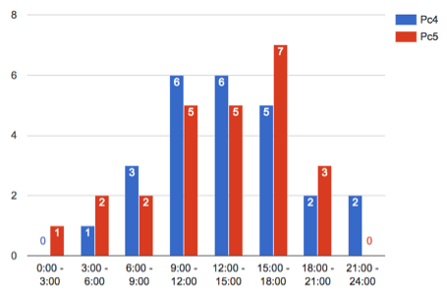
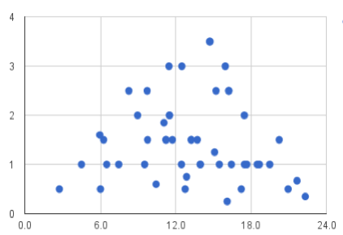
ULF: ST-5 Test Period
Occurrence Rate
10
Pc4
Initial Study March - June 2006
- GOES-10 & 12, overlapping ST5 mission period
- Most Pc4/5 events are dayside (06 - 18 LT)
- Occurrence rate:
- Same for Pc4 and Pc5 band events
- Peak rate is dusk (15-18LT)
- Longest duration events are post noon
- May be an indication of KHI generating significant toroidal mode events.
- Not well organized by Power or Freq vs. LT
This is a useful set for testing automated detection and study.
Pc5
6
4
2
LT
0-3 3-6 6-9 9-12 12-15 15-18 18-21 21-24
Span
4
3
Hours
1
LT
0 6 12 18 24

Slide 26
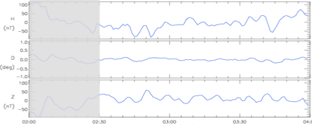
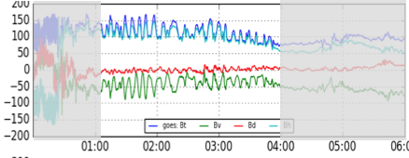
ULF Case 2: April 7, 2000
On April 6, a large geomagnetic storm initiated (Kp ~8+, |Dst| ~280 nT). April 7 (recovery phase) included a long period of ULF wave activity. An intense (>+/-50nT) ULF-Pc5 wave was obs both on the ground (MEA 61MLat, 307 MLon) and at GEO (296 MLon) (~01-04 UT, ~04-07 MLT).
Ground: Meanook (MEA)
MEA ~2.2 mHz, +/-25 nT from HDZ(z).
Similar to GOES-10 VDH(v) observations.
Higher temporal resolution would aid in resolving the shape.
GEO: GOES-10 (West)
G10 ~2.2 mHz, +/-30 nT (Bt) waves mostly in VDH(v,h), with v- and h- out of phase.
Similar amplitude and period to ground observations (MEA HDZ(z)).
MEA
Courtesy GCS, NRCan (3).
GOES-10
The mode of this oscillation is to be determined.
Notes:
“The oscillations in the GOES-10 data might be associated with some kind of instability rather than with typical continuous pulsations.”

Slide 27
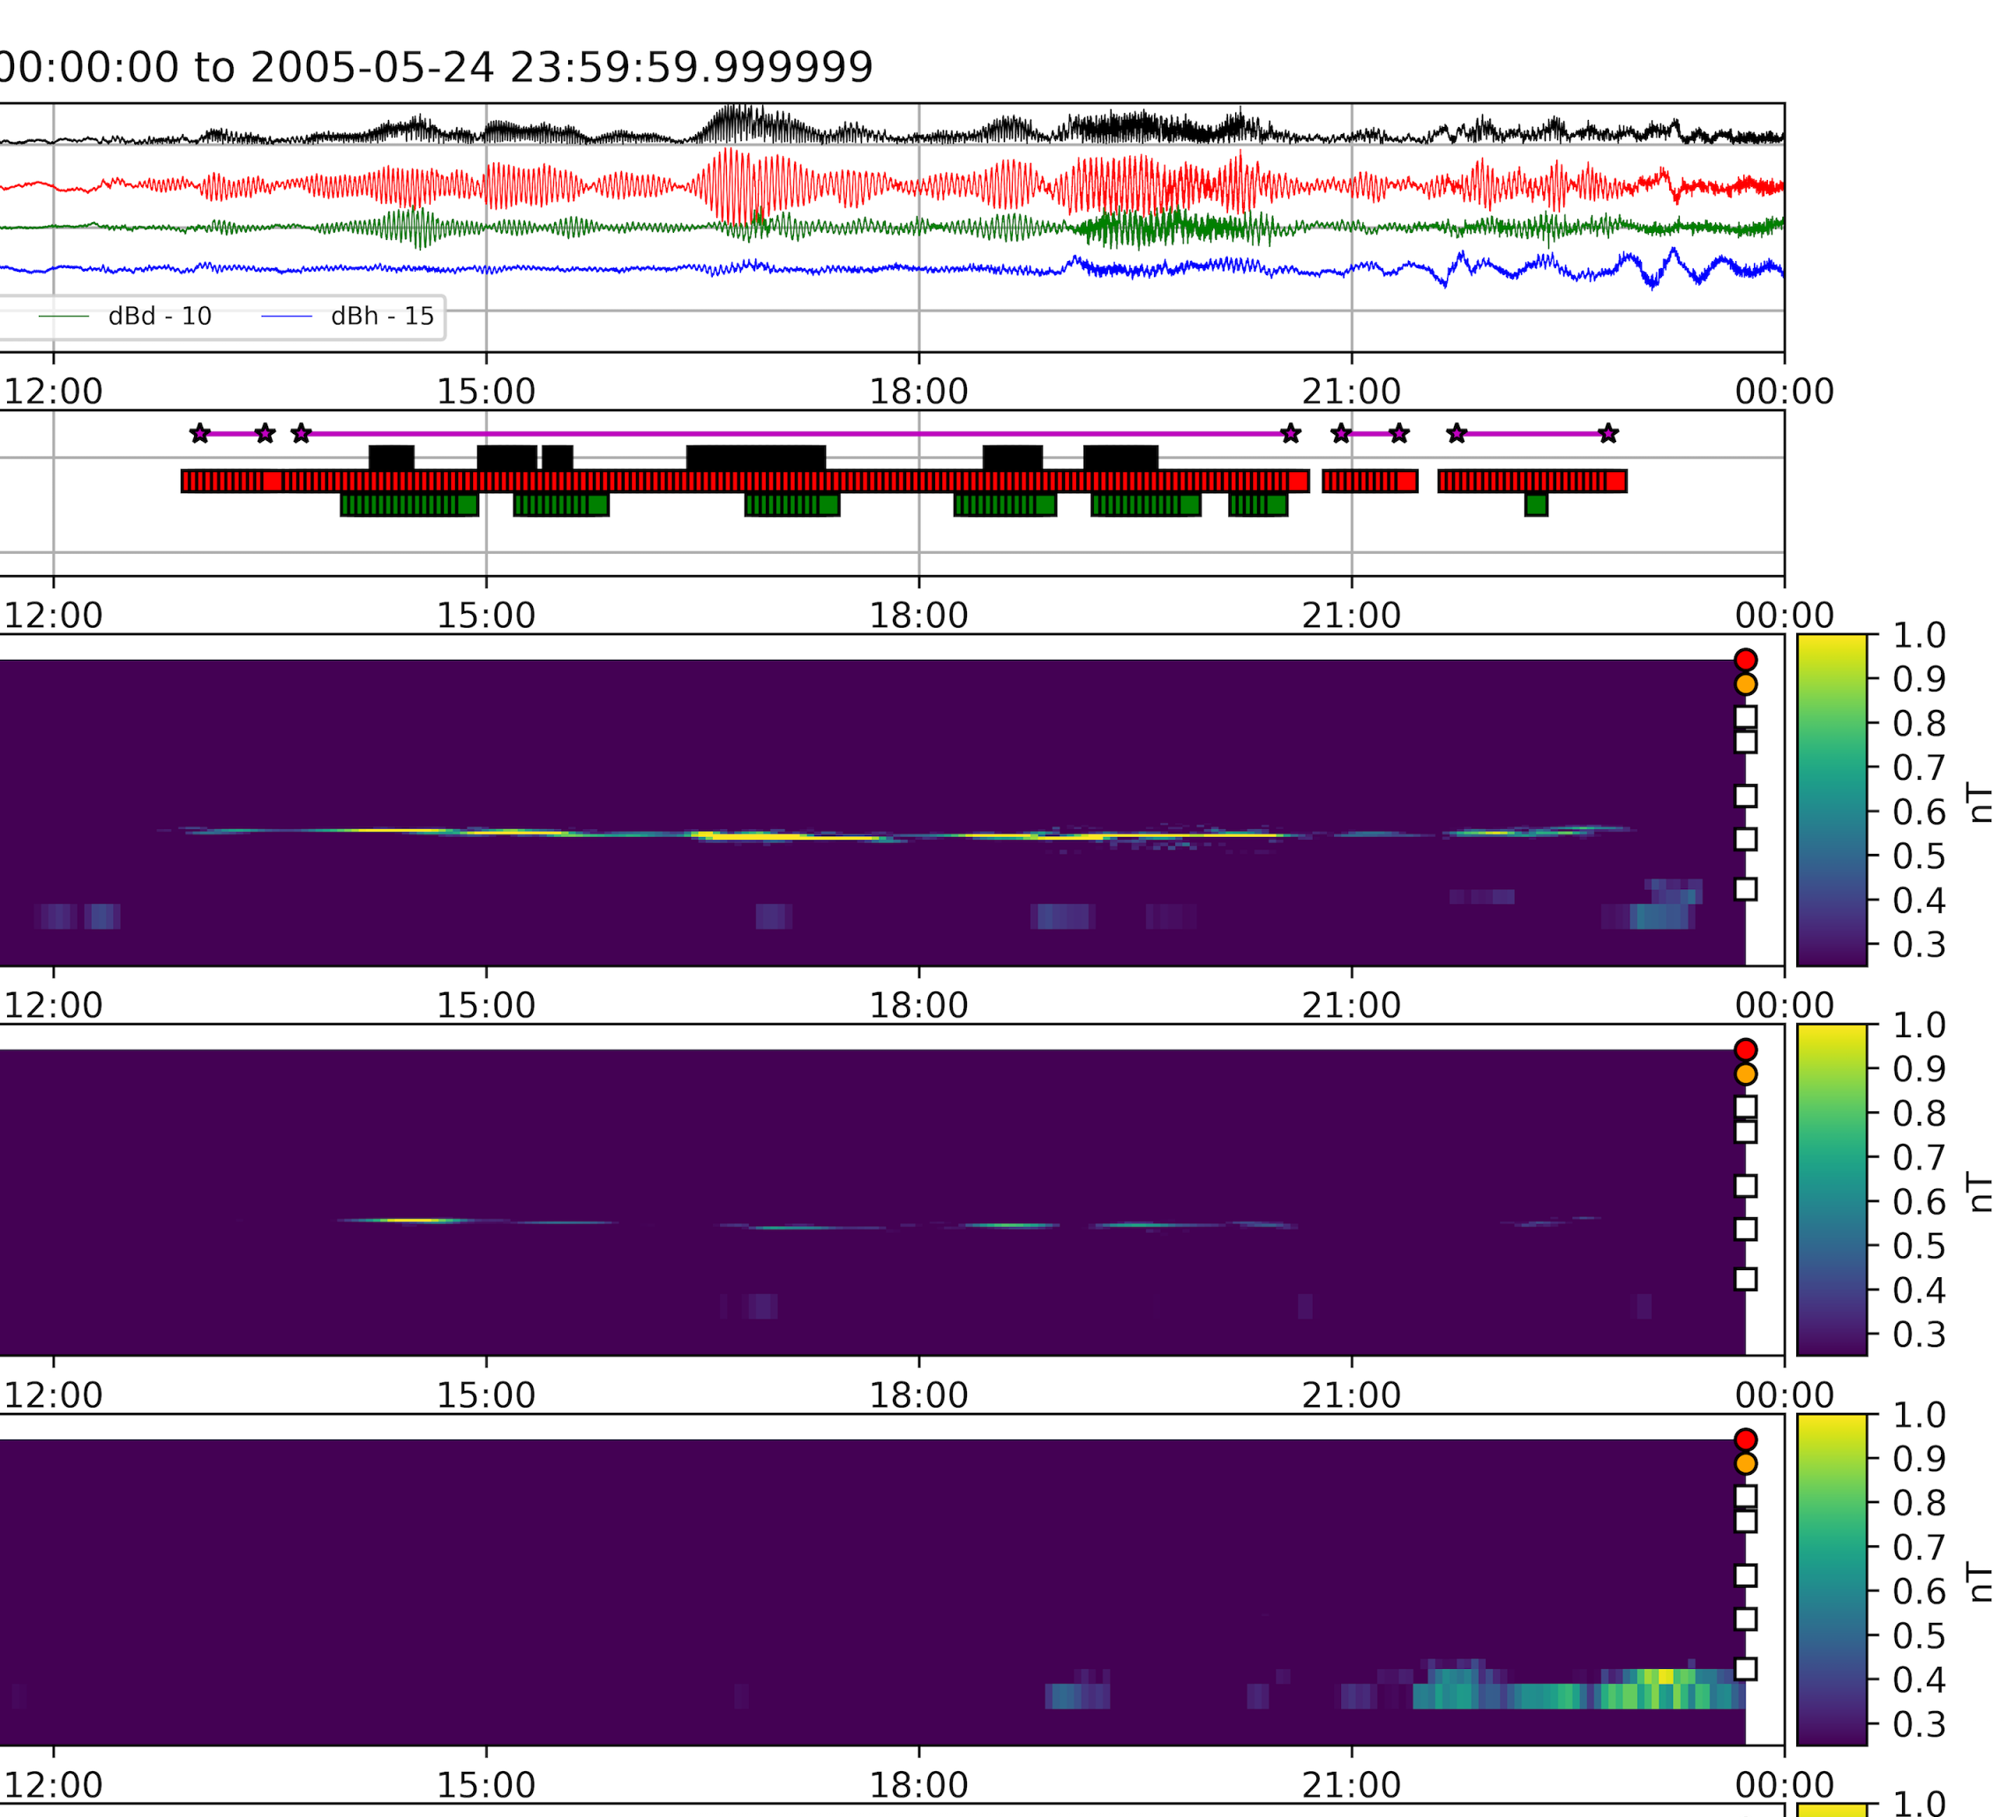
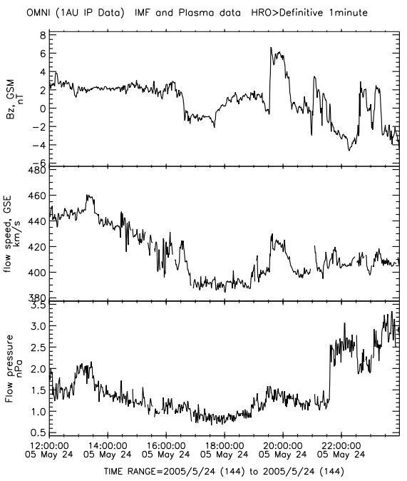
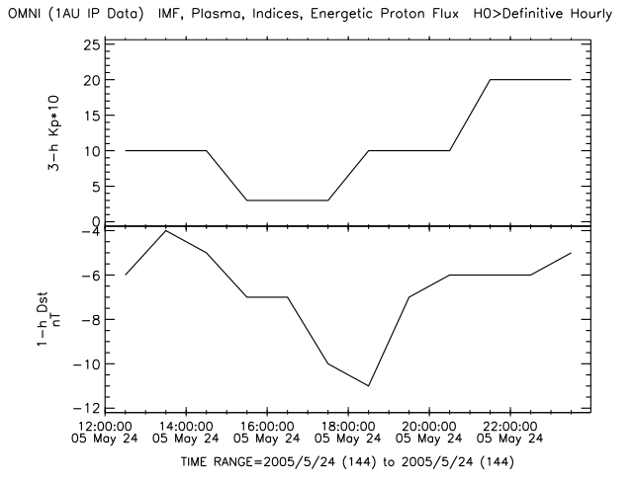
Significant Events: Longest, May 24, 2005
GOES-10 (West)
7.3 mHz
Space Weather - quiet
LT: 3 6 9 12 15
dB
ULF
dBv
dBd
dBh
Bz
Vsw
Poloidal
Dp
Toroidal
Kp
*10
Compressional
Dst

Slide 28
References
[1] Singer, H., Matheson, L., Grubb, R., Newman, A., & Bouwer, D. (1996). Monitoring space weather with the GOES magnetometers. Proc. SPIE Vol. 2812, 2812, 299–308.
[2] Hughes, W. J., McPherron, R. L., Barfield, J. N., & Mauk, B. H. (1979). A compressional Pc4 pulsation observed by three satellites in geostationary orbit near local midnight. Planetary and Space Science, 27, 821–840. http://doi.org/10.1016/0032-0633(79)90010-2.
[3] Le, G., Chi, P. J., Strangeway, R. J., & Slavin, J. A. (2011). Observations of a unique type of ULF wave by low-altitude Space Technology 5 satellites. Journal of Geophysical Research, 116(A8), http://doi.org/10.1029/2011JA016574.
[4] Chi, P. J., Johnson, J., Porazik, P. (2015). High-m Poloidal Waves Observed in Low Earth Orbit and Their Implications for Energetic Particles in the Magnetosphere, Fall AGU 2015, San Francisco.
[5] Cummings et al. (1969), JGR, 74, 778-793, 1969 and Ozeke et al.(2009), JGR, 114, A01214].
[6] Abdelqader, A., Redmon, R. J., Rodriguez, J. V. (2016), Magnetospheric Waves at Geostationary Orbit, NOAA Hollings Scholar project report.
[8] www.whitehouse.gov/sites/default/files/microsites/ostp/ostp_public_access_memo_2013.pdf
[9] https://www.nosc.noaa.gov/EDMC/documents/workshop2013/DLB-20130625_EDM_Virtual_Workshop_Opening_Remarks.pdf
[10] Huang, C.-L., H. E. Spence, H. J. Singer, and W. J. Hughes (2010), Modeling radiation belt radial diffusion in ULF wave fields: 1. Quantifying ULF wave power at geosynchronous orbit in observations and in global MHD model, J. Geophys. Res., 115(A6), doi:10.1029/91JA01860.

