Slide 1

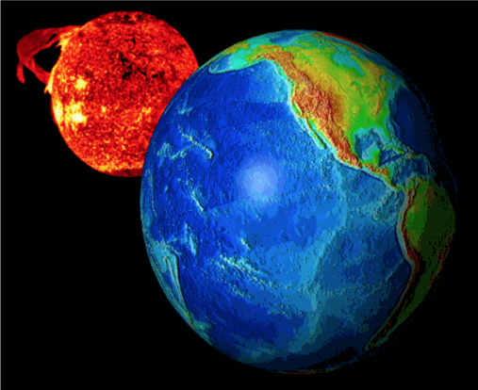

New GOES High-Resolution Magnetic Measurements
Characterization of ULF Waves (Pc 4-5)
R.J. Redmon, T.M. Loto’aniu, P.J. Chi, A. Abdelqader, H.J. Singer, A. Boudouridis, M. Tilton
(Rob.Redmon@noaa.gov)
April 24, 2017
EGU2017-7870
Notes:
We are resurrecting decades of GOES full resolution magnetometer measurements. We’ll demonstrate it’s utility though a survey of Pc ULF waves.

Slide 2
Outline
History of magnetic field measurements at GEO
NOAA’s Big Earth Data Initiative (BEDI)
GOES MAG High-Resolution Project
Applications
ULF Pc 4-5 Conjunction Case Studies
ULF Pc 4-5’s during ST-5 Era and beyond
Summary
References

Slide 3
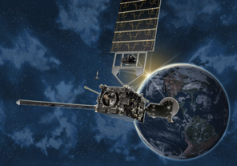
History…
NOAA - longest record of magnetic field observations at GEO.
SMS-1 (May, 1974) started the era of operational mag measurements.
GOES-8-12 initiated April 13, 1994.
GOES-13-15 initiated May 24, 2006. Presently operational.
GOES-16 (first of GOES-R series) was launched on Nov 19, 2016. (Magnetometer performance issues under study.)
 | GOES 8-12 | GOES 13-15 | GOES R-U
# Fluxgates | 2* | 2 | 2
Sampling Rate | 2 Hz | 2 Hz | 10 Hz
Filter Cutoff | 0.5 Hz | 0.5 Hz | ~2.5 Hz
Accuracy | 1 nT/axis | 1 nT/axis | TBD
Boom Length | 3 m | 8.5 m | 8.5 m
Notes:
NOAA maintains the longest record of magnetic field observations at GEO.
Today we’re focusing on two constellations, GOES-8-12 w/the first s/c launched in 1994 and GOES-13-15, presently our operational fleet.
The instrumentation has been improved over these eras including a longer boom, and more effective bandwidth covering the all important ULF to a majority of the EMIC range.

Slide 4
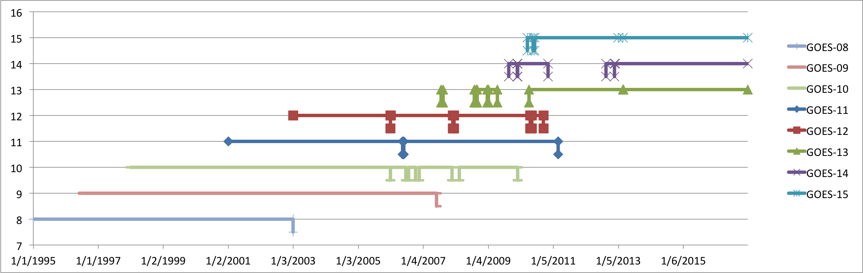



Data Continuity and Availability
The focus of this project is on:
Making GOES-8-12 (512 ms) available
Unifying the format and content of GOES-8 (12 spacecraft) – GOES-R
Note the many periods of 3 & 4, and 5 (1-min only) s/c availability.
G-15 (W)
G-14 (P)
G-13 (E)
G-12 (E)
G-11 (P)
G-10 (W)
G-09 (W)
G-08 (E)
1-min availability
1995
1997
1999
2001
2003
2005
2007
2009
2011
2013
2015
2017
Notes:
We’re focusing on continuity and availability.
We are making the entire missions of GOES-8-12 512 ms data available for the first time ever, from late 1994 through 2010.
NOAA only uses 2 GOES spacecraft operationally at any given time. Fortunately, the magnetometer has been on and telemetering data during storage periods.
With respect to scientific value, note the many periods of 5, 4, and 3 spacecraft availability.

Slide 5
Big Earth Data Initiative (BEDI)
Public Access to Research Results
The US Office of Science Technology Policy (OSTP) issued the Memo: “Increasing Access to the Results of Federally Funded Scientific Research” (February 22, 2013) [8].
Agencies with >$100M in annual research: results must be made available to the public, industry, and scientific community.
Big Earth Data Initiative (BEDI)
NOAA’s response: the Big Environmental Data Initiative (BEDI) [9]
Multi‐agency activity through the US Group on Earth Observations
Improve data discoverability, accessibility, and usability
Notes:
How are we funding this effort?
The US Office of Science Technology Policy issued the order to improve public access to research results.
NOAA chose to respond with the Big Earth Data Initiative which funds dataset improvements from Sun to Earth.

Slide 6
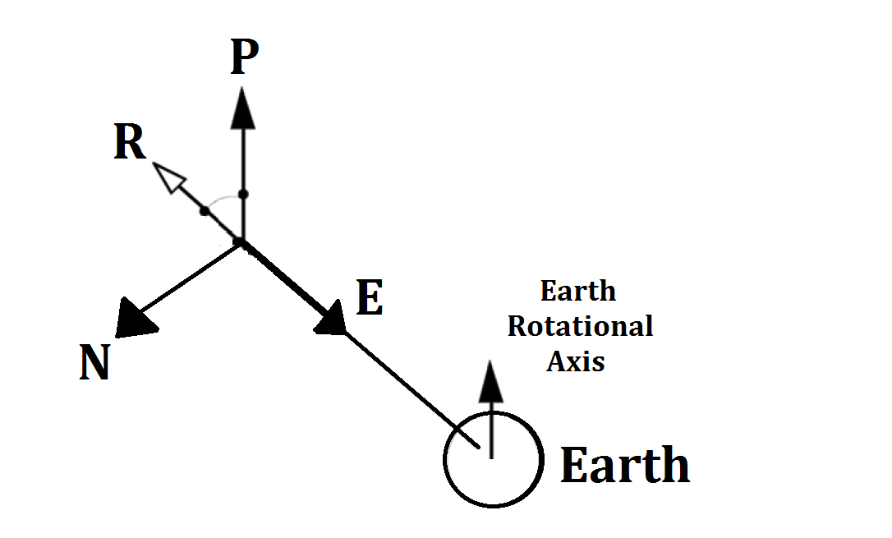
GOES MAG High-Res: Objectives
Goal: 20+ year archive, GOES-8-R series
Parameters (NetCDF):
Coordinate (current): Sensor, ECI, EPN
Coordinate (new): GSE, GSM, VDH
Ephemeris, spacecraft location
Data corrections:
Torquer; Calibration Factors;
Coded identification of “Best”
Data Validation: Manual and Automated
Future proofing: Published data, software
Derived products: Pc [1-5] banded power, ULF detection (to 1 Hz); Cross GOES calibration factors.
Coordinate Frames
EPN (classical)
  Local GEO
  E: Earthward
  P: Poleward
  N: Eastward
  ExP = N
VDH (new and used here)
  Dipole Aligned
  V: Radial
  D: East
  H: Dipole North
  VxD = H
H
V
D
Notes:
We are working on an authoritative reference archive for 20+ years.
They’ll be in NetCDF and include several space physics valuable coordinate frames and enough ephemeris information to rotate to the frame of your choice.
We’ll include known corrections and develop a processing pipeline for easily including future corrections.
We publish a description of all processing and software.
Derived products we are planning include Pc banded power and ULF wave detection and cross GOES calibration factors.
Today we will use the dipole aligned VDH frame for studying ULF waves.

Slide 7
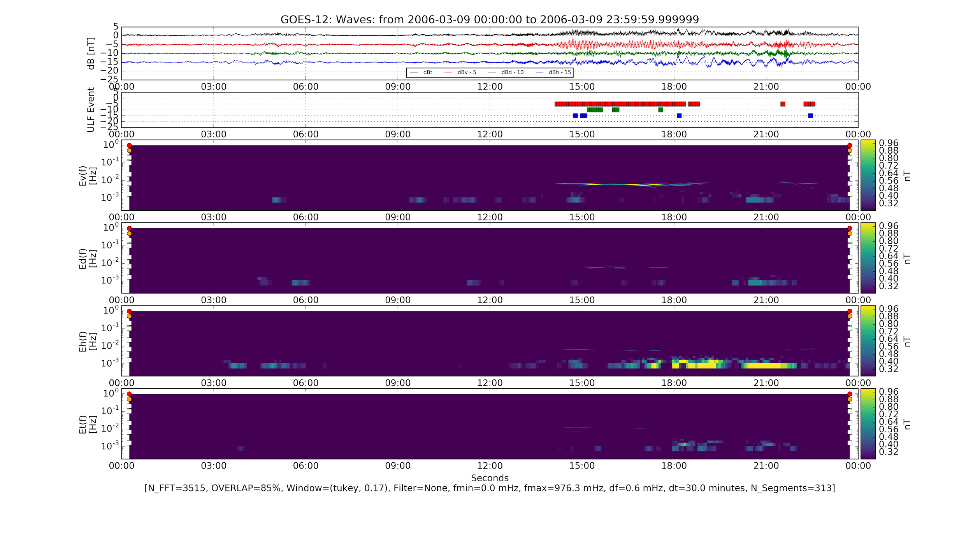
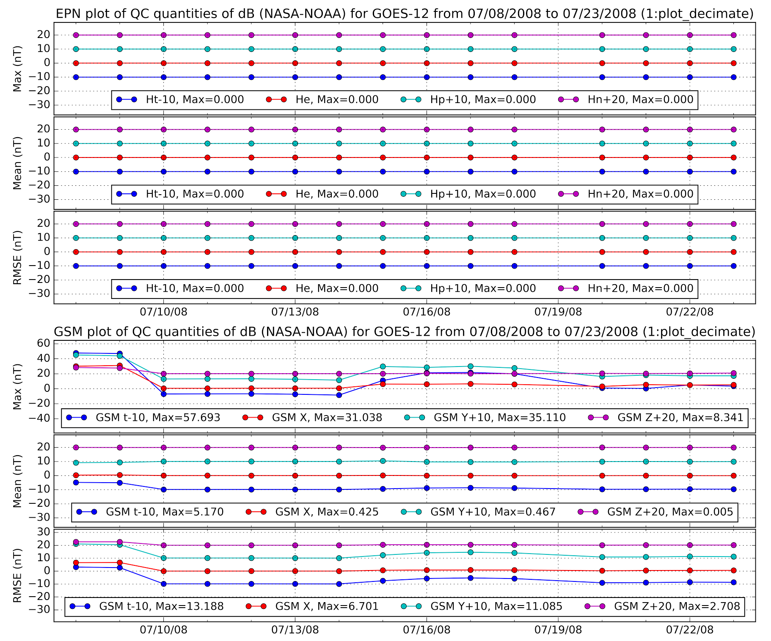
Reference Archives: Validation is Key!
Manual
Quality Figures
  Time series
  Spectrogram
  X-Y scatter
Automated (in progress)
Versus CDAWeb Truth Set
Versus NOAA Truth Set
Triggers to detect
  Spikes, heaters, Rx wheel
Intercalibration factors
Automatic
Ex: Automated Detection of ULF Pc4-5
Ex: Errors detected against “Truth” set
Notes:
For Reference Archives, Validation is Key!
We intend to include quality control browse graphics alongside the dataset and a process for detecting changes from the current “Truth Set”
Here we’re showing an example detecting an error in the EPN => GSM rotation on the bottom right and ULF wave events on the top right.
We will include several types of browse graphics so you can begin your science.

Slide 8
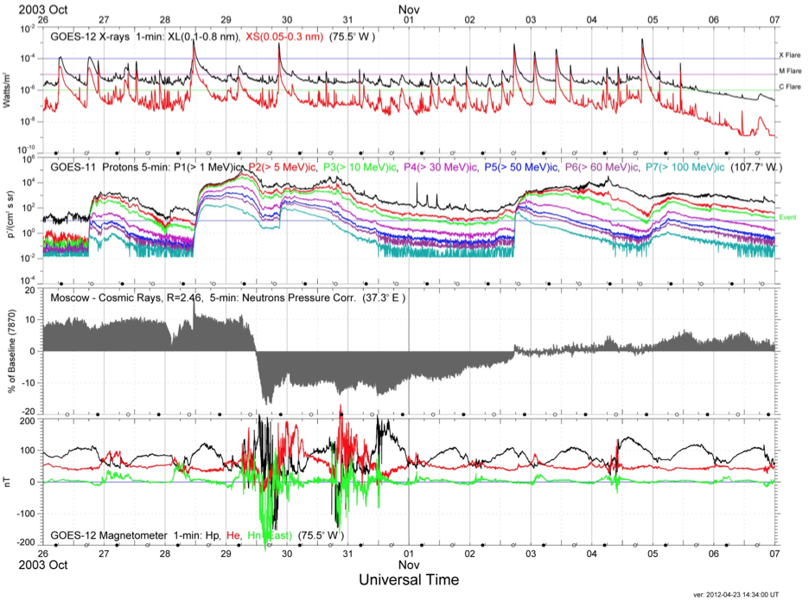
GOES MAG: Space Wx Suite
Halloween Storm 2003 GOES-11 (107W) and GOES-12 (75W)
X-rays
Watts/m2
Multiple X class flares
Protons
#/cm2/s/sr
Multiple SEP events
GCR
%
Forbush Decrease
B field
nT
MP Crossings
Notes:
What about GOES in the Space Weather context?
The MAG is part of the SEM space environment suite.
For example, during the Halloween Storm of 2003, GOES observed several X-class flares, solar energetic proton events and geosynchronous magnetopause crossings.

Slide 9
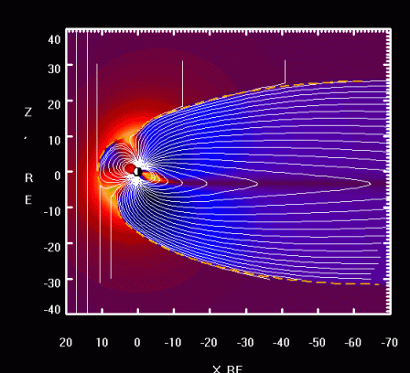
GOES MAG: Research and Applications
Our thoughts while creating this new dataset...
Ring Current and Radiation Belts
Conjunction studies
Plasma Waves
Magnetic field modeling
Storm, Substorm dynamics
S/C Intercalibration
Thus, your feedback is critical for the best outcome!
http://geo.phys.spbu.ru/~tsyganenko/modeling.html
Notes:
We’re thinking about the value of these measurements for studies including the ring current, radiation belts, field aligned conjunctions, plasma waves, magnetic modeling, storm and substorm dynamics and spacecraft inter-calibration.
Thus, your feedback is critical for the best outcome!

Slide 10
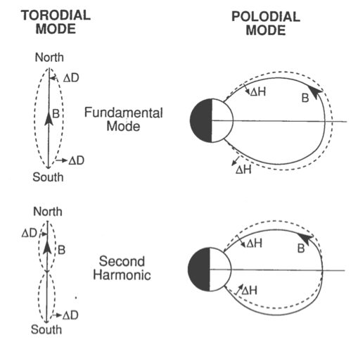

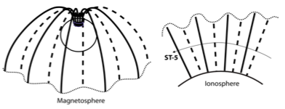
Using a new rich dataset: ULF Pc 4-5 Waves
Theoretical:
Global Oscillations
Observations: Ground
For the example next, ground stations on GEO field line, observe Pc4-5 ULF. Phase cross coherence can be used to confirm FLR nature.
Low Altitude
LEO high-latitude spacecraft such as ST-5 transverse wavefield [3].
Ex: FLR Toroidal Mode
ST5
ST5
PBQ
G12
From Le et al. 2011 [3].
G12
Credit: Andy Kyle, University of Alberta)
GEO
Magnetospheric observations, such as from GOES-12 obs ~Pc4-5 ULF.
Field line oscillation in the 2 lowest frequency toroidal (left) and poloidal (right) modes. (From Hughes et al. 1979 [2])
Notes:
Next we demonstrate the value of this rich new dataset in describing a FLR.
FLRs are full field line fluctuations who’s motion can be described by poloidal and toroidal oscillations.
Note the toroidal mode in the movie from the Univ. of Alberta.
Oscillations can be observed along the entire field line from ground through the ionosphere to the magnetosphere.
With GOES at the equator, 2nd harmonic oscillations will show as radial magnetic field deflections.

Slide 11
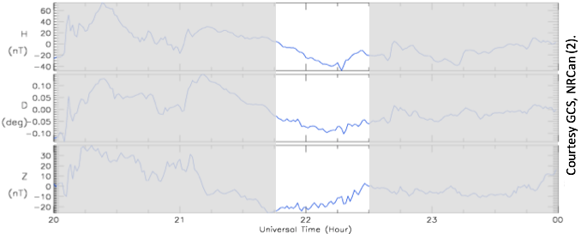
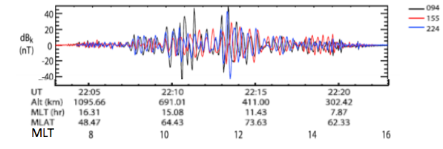
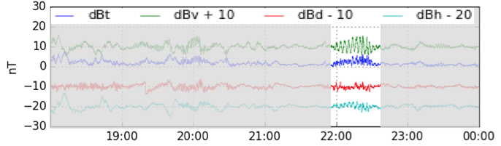
ULF FLR: Case 1: Conjunction Study May 7, 2006
A high-m number, Poloidal mode event near Noon on May 7, 2006 presents an example, confirming theoretical predictions of wave propagation from the magnetosphere to the ground [3,4,5].
Ground: Station Post de-la-Baleine (PBQ)
PBQ (65MLat, 352MLon) Pc4-5, ~4.4 mHz, +/-3.1 nT mainly in HDZ(z). FLR nature was confirmed in [3] using cross-phase technique.
Low Altitude: Satellite ST-5
ST5 ~70mHz, +/-20 nT waves in transverse (maximum variance) component (dBk).
Waves were observed in Pc1-2 band, but are Doppler shifted Pc4-5 waves, i.e. they are 5.3+/-1.9 mHz in the Earth frame [3,4].
GEO: GOES-12 (East)
G12 (357 MLon) Pc4-5, ~5.3 mHz, +/-3 nT waves mostly in VDH(v,h) components (in phase).
PBQ
Courtesy GCS, NRCan (3).
ST-5
GOES-12
Notes:
As demonstration of the richness of a long continuity GOES full resolution magnetometer dataset in geophysically relevant frames, consider the FLR observed by the low earth orbiting ST5 constellation, traversing the ionosphere wave field as reported in Le et al 2011.
Adding the GOES equatorial magnetosphere measurement allows us to further constrain the resonance.
After testing for true FLR via cross-phase techniques, we see the earth frame resonance is Pc4-5 all along the field line.

Slide 12
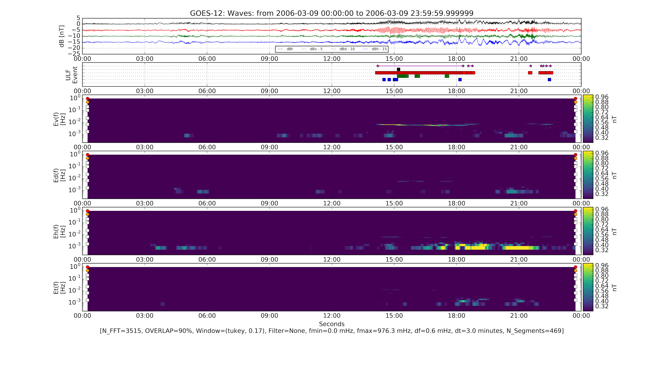
ULF: Automatic Classification
GOES-12 (East) Observes
ULF Pc4-5 for 5 Hours in the ~Poloidal (v) component
Methodology Fourier
Detrend db = B - <B>
PSD Spectrogram
  Tukey window
  90% overlap
  3 Pc5 periods
  df ~ 0.6 mHz
  dt ~ 3 minutes
Simple peak detection
  df/f < 0.25
  B_{peak} > 0.5 nT
Save Intervals
dB
ULF
Bv
Bd
Bh
Bt
Poloidal (Bv)
Toroidal (Bd)
Compress (Bh)
ULF detected
Poloidal
Notes:
How about a database of automatically detected and classified ULF waves?
We’ve developed a simple Fourier methodology to locate intervals of Pc waves.
Essentially, we look for monochromatic or narrowband peaks in the power spectral density.
We plan to create a full GOES ULF database.

Slide 13
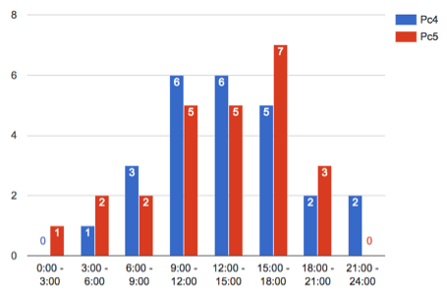
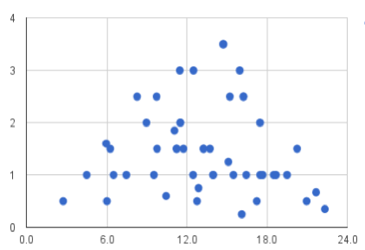
ULF: ST-5 Period and Beyond
Occurrence Rate
10
Pc4
Initial Study March - June 2006
- GOES-10 & 12, overlapping ST5 mission period
- Most Pc4/5 events are dayside (06 - 18 LT)
- Occurrence rate:
- Same for Pc4 and Pc5 band events
- Peak rate is dusk (15-18LT)
- Longest duration events are post noon
- May be an indication of KHI generating significant toroidal mode events.
- Not well organized by Power or Freq vs. LT
This is a useful set for testing automated detection and study.
Pc5
6
4
2
LT
0-3 3-6 6-9 9-12 12-15 15-18 18-21 21-24
Span
4
3
Hours
1
LT
0 6 12 18 24
Notes:
We needed a test set…
Our scholarship student of last summer, hand analyzed all radial deflections during the 90-day ST5 mission in 2006 and found these very preliminary results.
They were reasonably agreeable to the literature and highlighted our technique was probably good enough.
Caveats/Comments:
- 3 HSS, otherwise period was relatively quiet
- Onsets were detected using the VDH(v) radial only.
- Did not distinguish between toroidal and poloidal modes.
- Some bias/quantization (note near 1 hour in right figure).

Slide 14
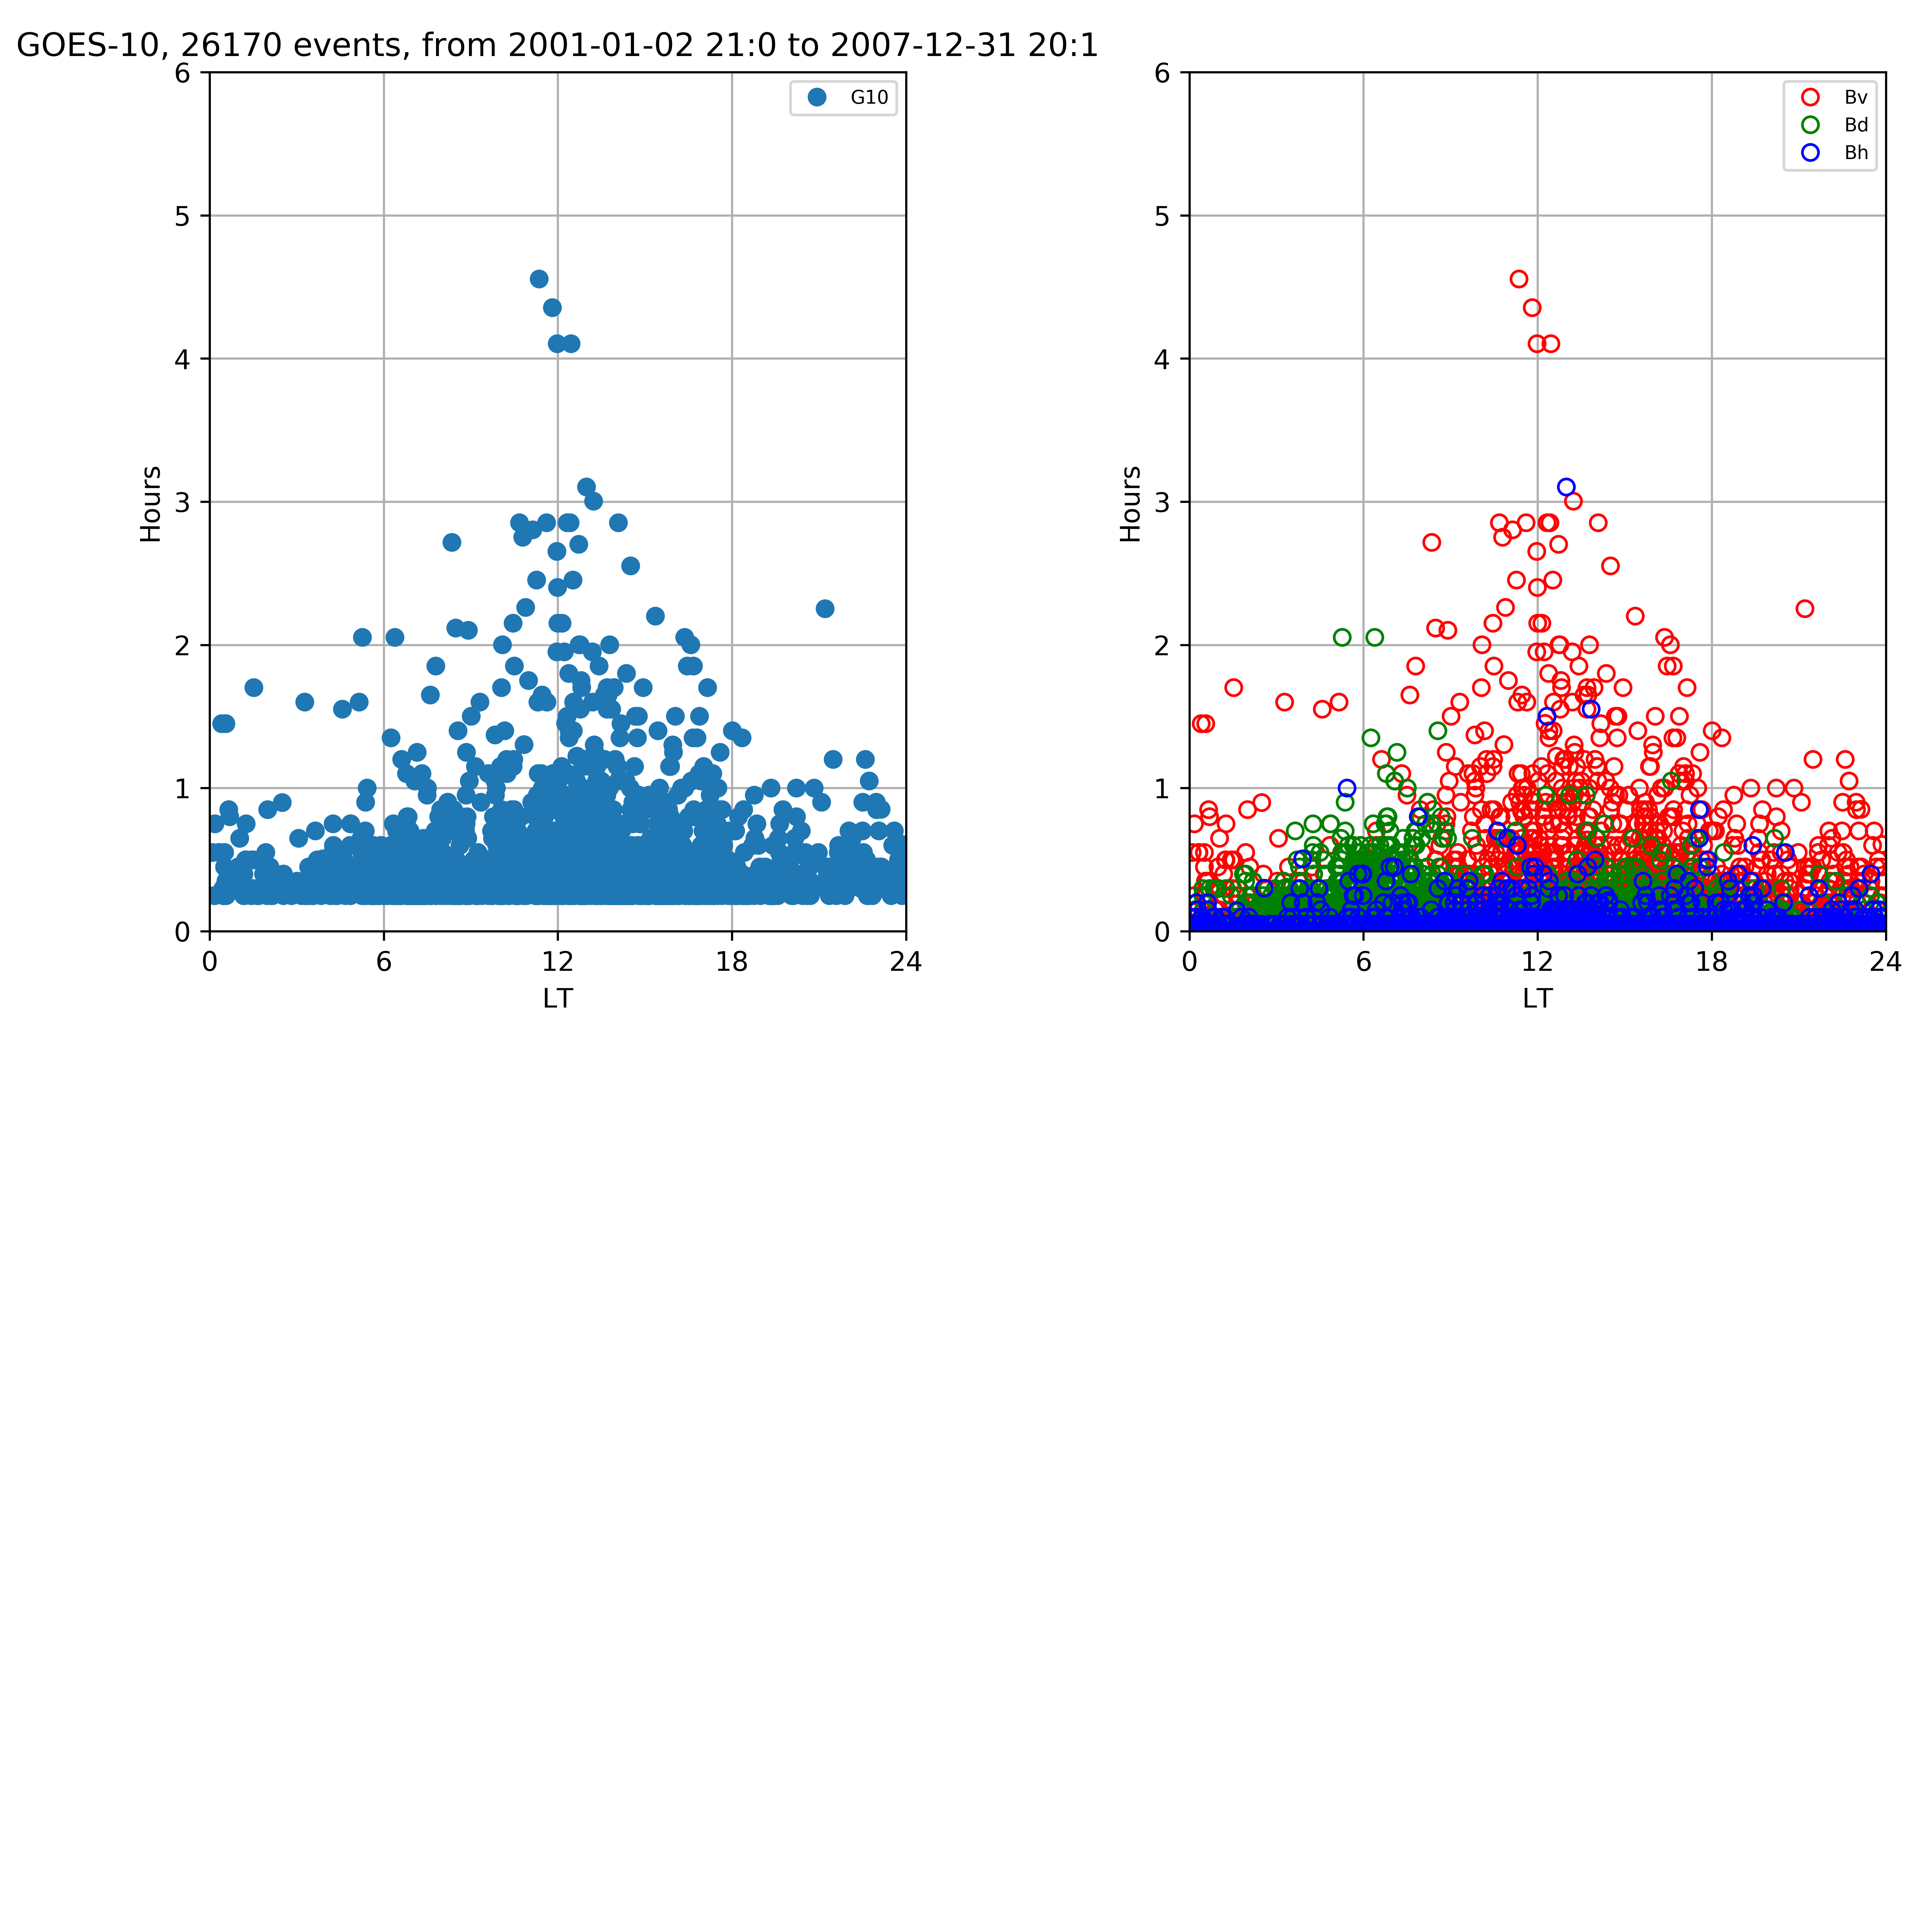
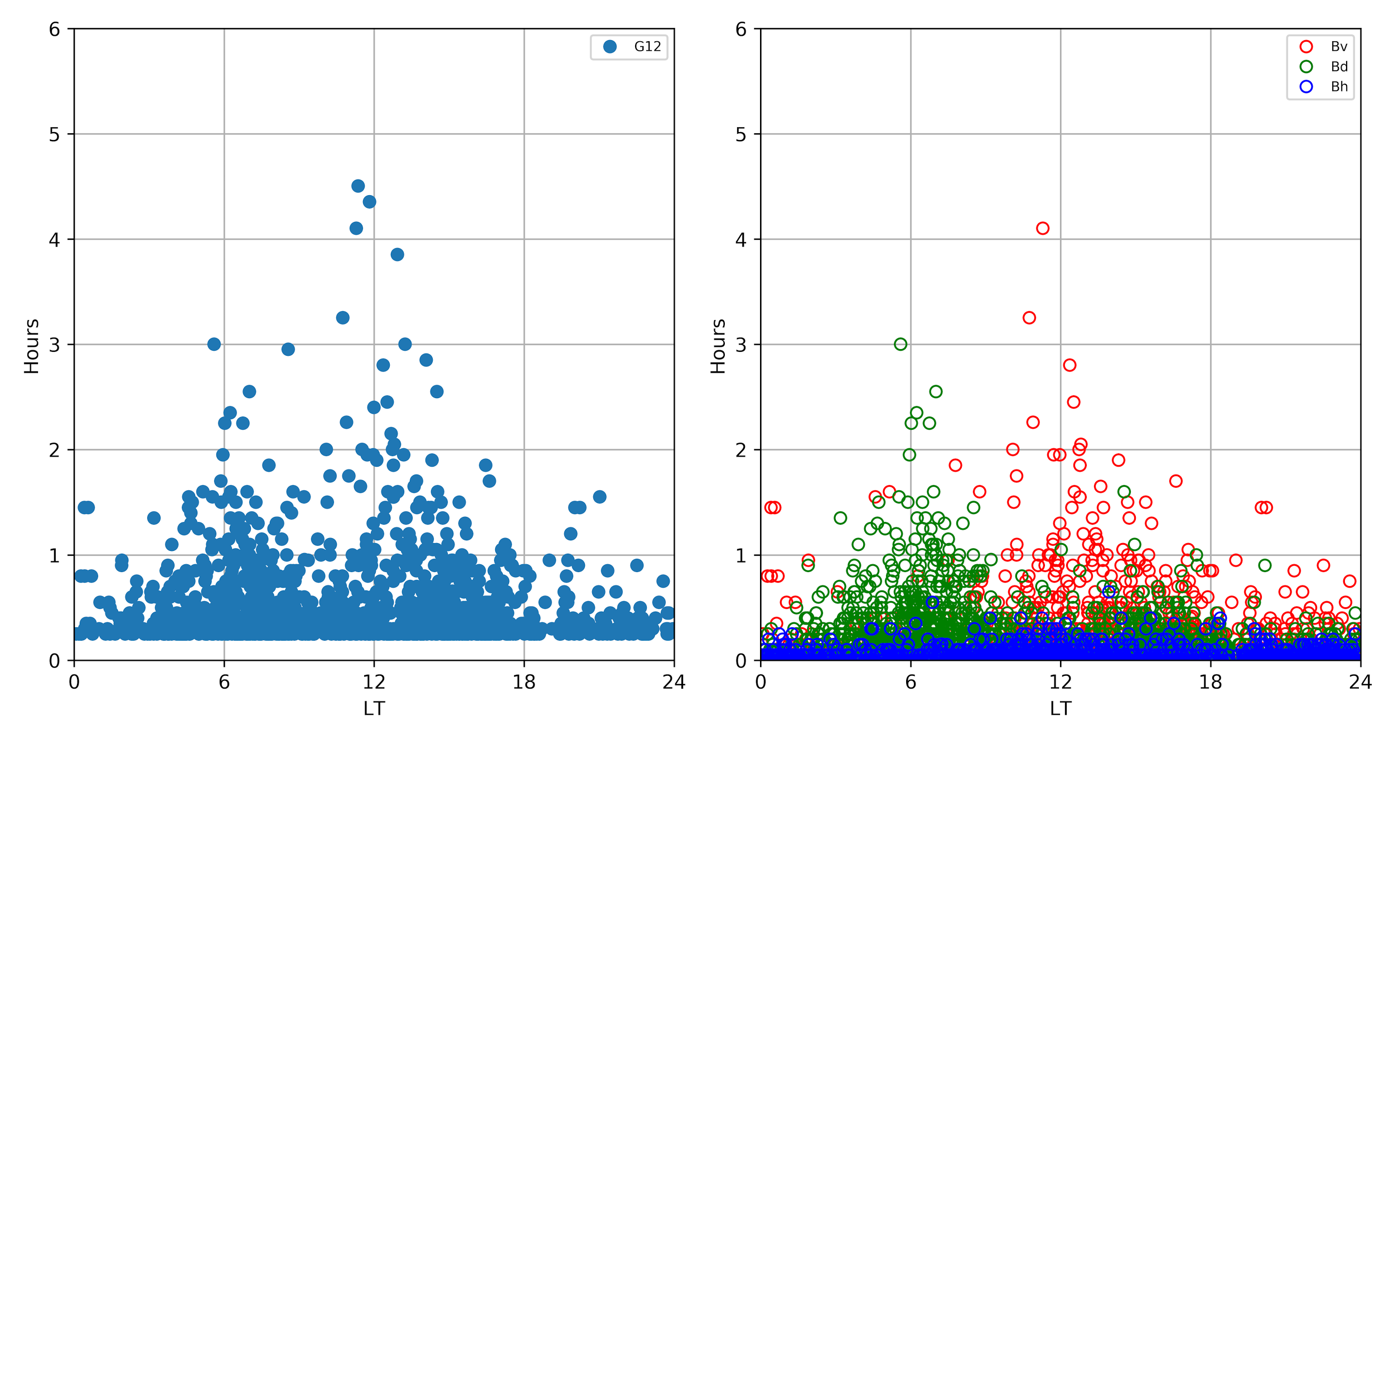
Pc4-5 ULF: Declining phase of SC23 ~2001-2007
Component Comparison
Poloidal (dBv) dominates noon
Toroidal (dBd) dominates flanks w/6>18
Compressional (dBh) limited
Solar wind connection
Significant Events
Longest: 10 hrs on May 24, 2005
  7.3 mHz at 9 LT with 1-5 nT dominant Poloidal (GOES10).
  SpWx: Quiet (see slide 19)
Largest fluctuation (>15 min)
  Oct 1, 2002 with ~ 1hr, >+/- 20 nT in both V, H.
GOES-10&12
26k Events
4
90
Deg
Hours
~2.5-20 mHz
~450 - 50 sec
2
30
1
15
LT
0 6 12 18 24
Notes:
Further demonstrating the potential use and richness of the new GOES full resolution magnetometer dataset, we have automatically detected ULF intervals over the 7-year declining phase of SC23.
What did we find?
- Reasonable agreement with the equally rich literature.
- Solar wind connection:
-- Flanks are dominated by toroidal mode associated with KHI instability.
--- Preference for dawn toroidal mode events is likely due to Parker spiral as IMF is statistically more likely to be perpendicular to MP boundary at dawn.
-- Poloidal mode due to SW Dp buffering magnetosphere.
Comment related to Largest fluctuation:
- 2003 Halloween storm has many ULF intervals. Monochromatic periods are hard to identify.

Slide 15

Summary
New authoritative Reference Environmental Data Records (EDR) for GOES 8,9,10,11,12,13,14,15, 1995-Present.
Geophysical coordinate frames: GSE, GSM, VDH
Automated validation.
ULF Pc waves database
Several applications described.
Initial findings presented
Feedback will be greatly appreciated!
Notes:
The products in blue are all new.

Slide 16
Backup Slides

Slide 17
Acknowledgements
The authors thank the following persons and institutions for their support in this endeavor:
(1) NOAA’s Big Earth Data Initiative (PM: J. de la Beaujardière) has funded the current effort.
(2) A. Newman, L. Matheson, H. Farthing, D. Wilkinson, H. Bysal; NCEI, SWPC.
(3) MAG ground station data was provided by David Calp (NRCan/RNCan) via the Geological Survey of Canada (GSC) and National Resources Canada (NRCan). http://www.geomag.nrcan.gc.ca/index-en.php

Slide 18
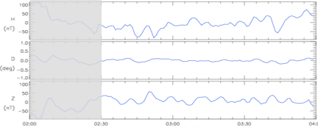
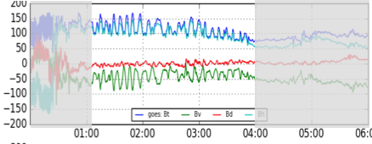
ULF Case 2: April 7, 2000
On April 6, a large geomagnetic storm initiated (Kp ~8+, |Dst| ~280 nT). April 7 (recovery phase) included a long period of ULF wave activity. An intense (>+/-50nT) ULF-Pc5 wave was obs both on the ground (MEA 61MLat, 307 MLon) and at GEO (296 MLon) (~01-04 UT, ~04-07 MLT).
Ground: Meanook (MEA)
MEA ~2.2 mHz, +/-25 nT from HDZ(z).
Similar to GOES-10 VDH(v) observations.
Higher temporal resolution would aide in resolving the shape.
GEO: GOES-10 (West)
G10 ~2.2 mHz, +/-30 nT (Bt) waves mostly in VDH(v,h), with v- and h- out of phase.
Similar amplitude and period to ground observations (MEA HDZ(z)).
MEA
Courtesy GCS, NRCan (3).
GOES-10
The mode of this oscillation is to be determined.
Notes:
PC: “The oscillations in the GOES-10 data might be associated with some kind of instability rather than with typical continuous pulsations.”

Slide 19
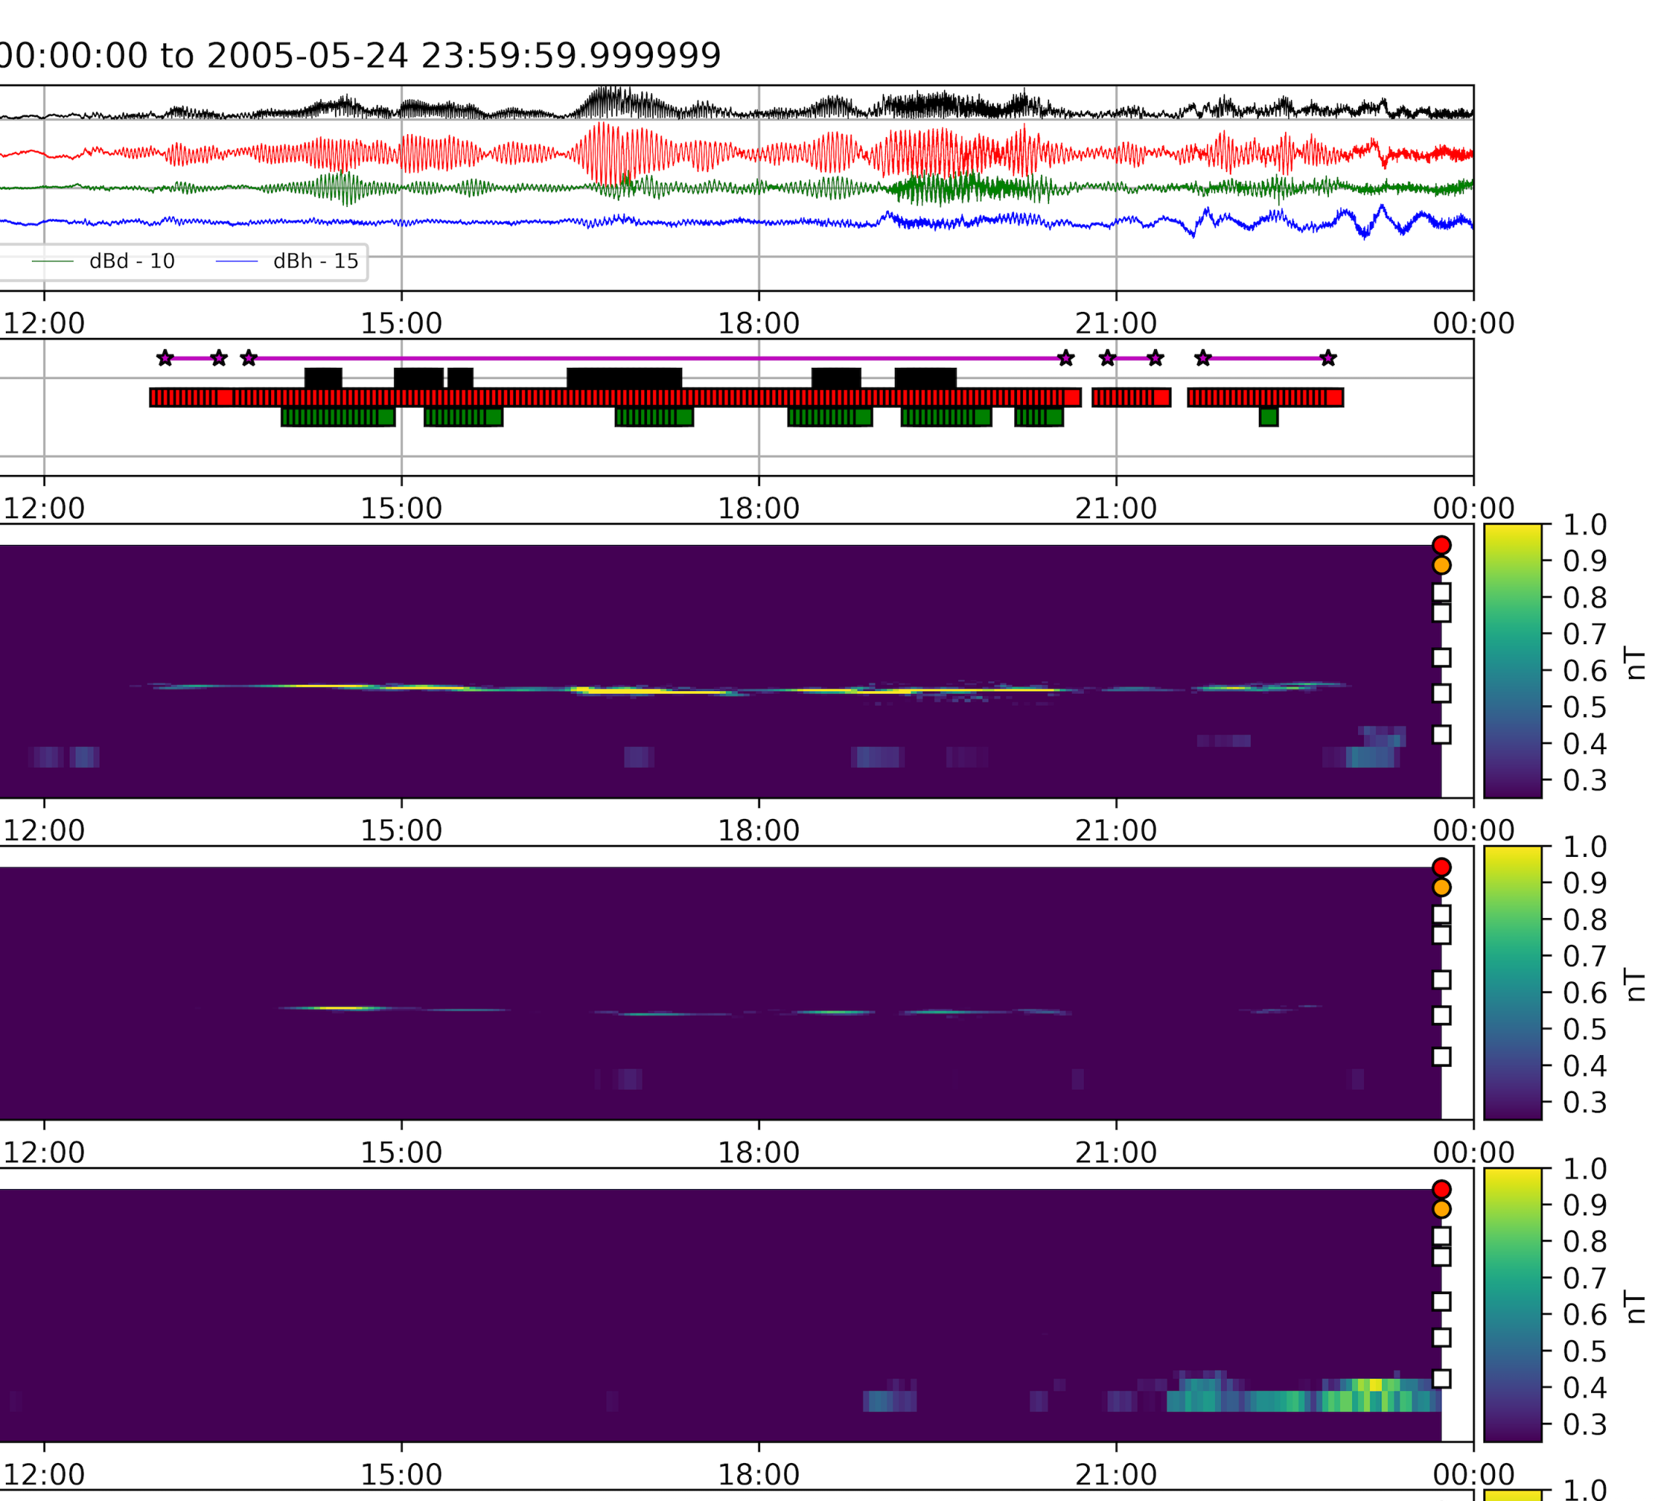
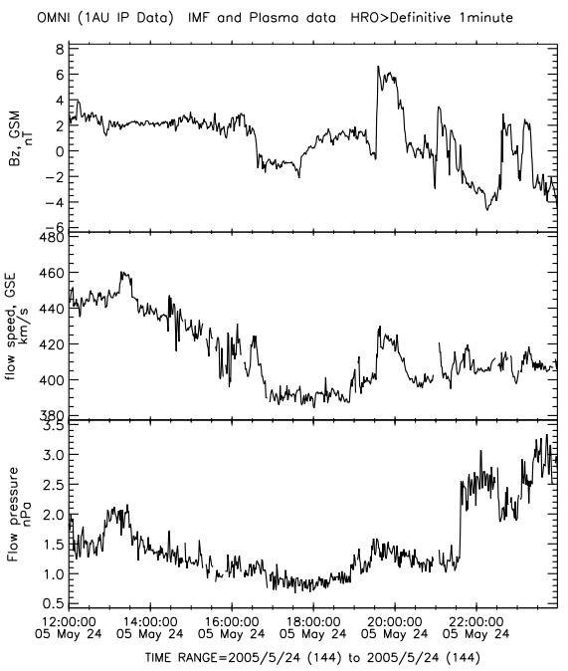
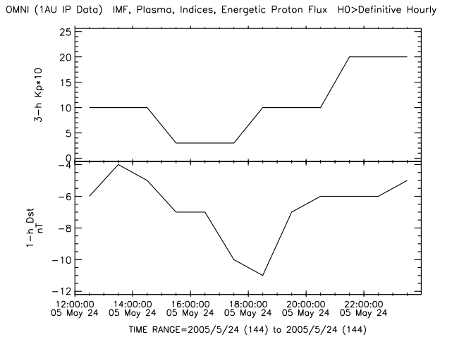
Significant Events: Longest: May 24, 2005
GOES-10 (West)
7.3 mHz
Space Weather - quiet
LT: 3 6 9 12 15
dB
ULF
dBv
dBd
dBh
Bz
Vsw
Poloidal
Dp
Toroidal
Kp
*10
Compressional
Dst

Slide 20
References
[1] Singer, H., Matheson, L., Grubb, R., Newman, A., & Bouwer, D. (1996). Monitoring space weather with the GOES magnetometers. Proc. SPIE Vol. 2812, 2812, 299–308.
[2] Hughes, W. J., McPherron, R. L., Barfield, J. N., & Mauk, B. H. (1979). A compressional Pc4 pulsation observed by three satellites in geostationary orbit near local midnight. Planetary and Space Science, 27, 821–840. http://doi.org/10.1016/0032-0633(79)90010-2.
[3] Le, G., Chi, P. J., Strangeway, R. J., & Slavin, J. A. (2011). Observations of a unique type of ULF wave by low-altitude Space Technology 5 satellites. Journal of Geophysical Research, 116(A8), http://doi.org/10.1029/2011JA016574.
[4] Chi, P. J., Johnson, J., Porazik, P. (2015). High-m Poloidal Waves Observed in Low Earth Orbit and Their Implications for Energetic Particles in the Magnetosphere, Fall AGU 2015, San Francisco.
[5] Cummings et al. (1969), JGR, 74, 778-793, 1969 and Ozeke et al.(2009), JGR, 114, A01214].
[6] Abdelqader, A., Redmon, R. J., Rodriguez, J. V. (2016), Magnetospheric Waves at Geostationary Orbit, NOAA Hollings Scholar project report.
[8] www.whitehouse.gov/sites/default/files/microsites/ostp/ostp_public_access_memo_2013.pdf
[9] https://www.nosc.noaa.gov/EDMC/documents/workshop2013/DLB-20130625_EDM_Virtual_Workshop_Opening_Remarks.pdf
[10] Huang, C.-L., H. E. Spence, H. J. Singer, and W. J. Hughes (2010), Modeling radiation belt radial diffusion in ULF wave fields: 1. Quantifying ULF wave power at geosynchronous orbit in observations and in global MHD model, J. Geophys. Res., 115(A6), doi:10.1029/91JA01860.

